Slide 1
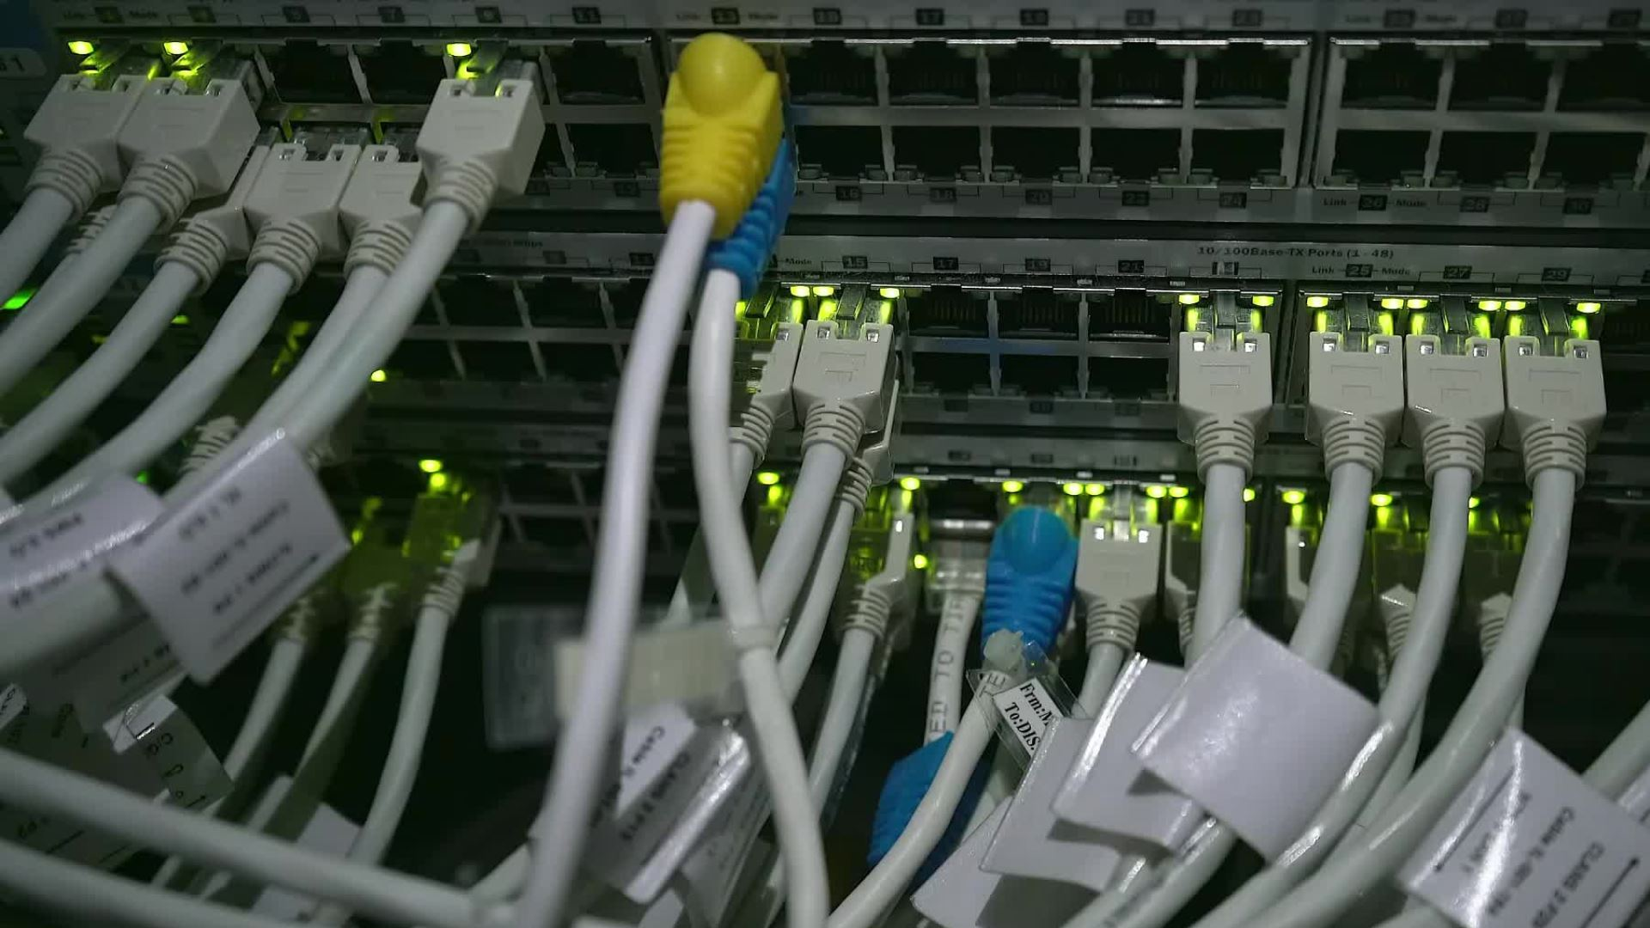

Networking Training Modules
e
Caden Kelly, John Haverlack
Notes:
Have a terminal on one screen of their vm, and the slides ona nother so I don't need to go back and forth a bunch
Introduce ourselves, what we hope they get out of it (inspiration to create their own networksa and firewalls, and the knowledge to do so, or if not, at least the conceptual grasp that will help them be able to do so in the future if they do. Ideas that can be applied across different types of firewall/data center software; concepts > specific implementation

Slide 2
Note: Have terminology sheets already out
https://drive.google.com/file/d/1453nKcI7BZ03UPW69p4fKi_TH23mH3DW/view?usp=sharing

Slide 3
Module 1 Agenda: IPv4 Network Basics
M1:
1:30pm – 1:50pm - Your terminal, Linux
1:50pm – 2:20pm - Binary, IPv4, (ping, broadcast, subnets and their mask, etc.)
2:20pm – 2:50pm - DHCP/MAC/DNS
2:50pm – 3:00pm - 10 minute break
3:00pm – 3:30pm - NTP, LAN, Network Segmentation
End of Module 1
​

Slide 4
Wi-Fi Login
TrainingGroundWifi
Password: ACEP1234!?
Lesson 1

Slide 5
Question: If your computer had no desktop, no icons, and no mouse, could you still use it?
Notes:
Show by doing ctrl alt f1, then ctrl alt f7

Slide 6

Continued...
"ls"
Do you see "Desktop" raise hand ifnot
"cd Desktop"
"mkdir WSSH"
Open terminal
"cd WSSH"
linux: sudo apt install python3-pippython3-venv
Windows: go to the online puythonstore>downloads>windows>installmanager
Install python:
mac: brew install python
Notes:
These slides are hidden because they detail how to download WSSH into your own computer instead of doing it through the jump host's WSSH service

Slide 7
Continued...
Still in the directory (folder) you made, "python3 –m venv venv"
"source venv/bin/activate"
*every time you want to start the envioronment to run wssh, type thatwhile in the appropriate folder
"pip install webssh" *only needs to be done once
Open the manager and install it.
"wssh"
Go to your browser/google
Type https://localhost:8888 into the search bar

Slide 8
Continued...
Use the slip of info we gave you to login to your WEBSSH computer
Wait for directions
Note:
Ctrl+C to leave the wssh program inside your terminal
"deactivate" to end the virtual environment
Notes:
At this point I should also be on the WEBSSH Screen

Slide 9
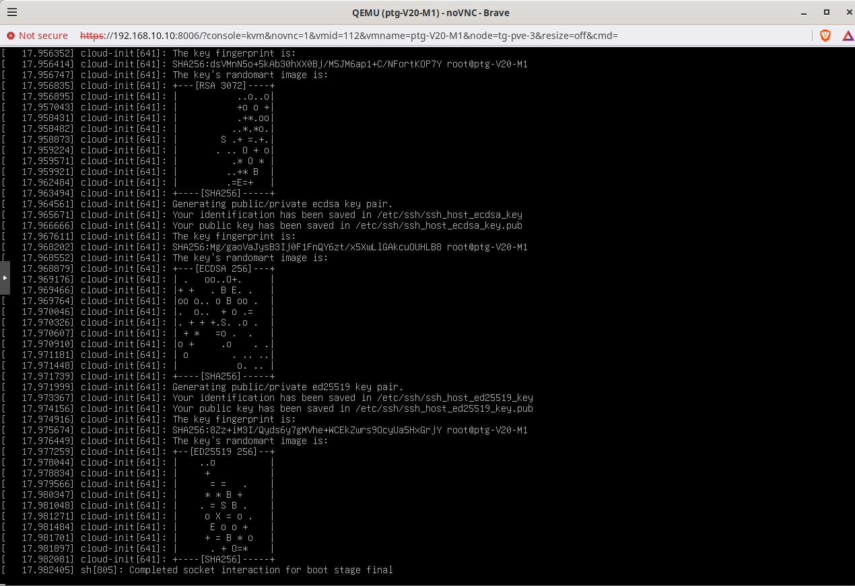
What are terminal and Linux command line?
The terminal (AKA shell, console, etc.) is an interface that lets you interact with the computer's operating system (OS)
File system demo
The command line is where you can type
Windows, MacOS, Linux, etc. are very different. Problem?
Lesson 1
Notes:
Mention that it can manage your entire computer; including network checks, how it runs, data from its hardware, etc. Etc. Etc.
One thing it does it file system navigation; compare it to inside their actual computer. We will start with this idea, then transition into network addressing capabilities
Showing one way to access: 2 different ways to access; wssh do first vs pm. After linux command line have them wssh into proxmox

Slide 10
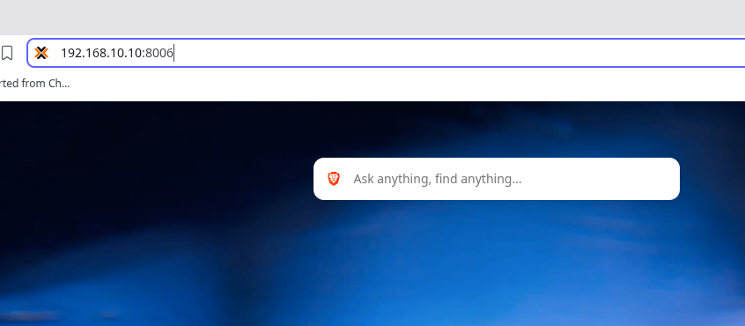
Type this into your search bar
Lesson 1
Notes:
They will type the address into their search bar to reach the interface
They need proxmox because they will need console access when they reset IPs, so if they tried to WSSH it would kick them out and we don't want to deal with that
SO to reduce the amount of logins I am having them just start module 1 with proxmox, then do wssh with module 2

Slide 11
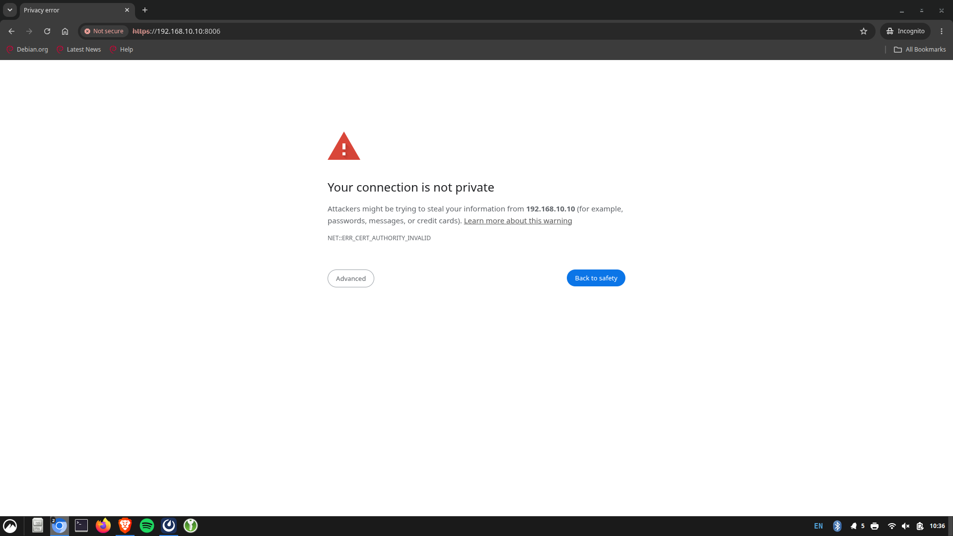

Slide 12
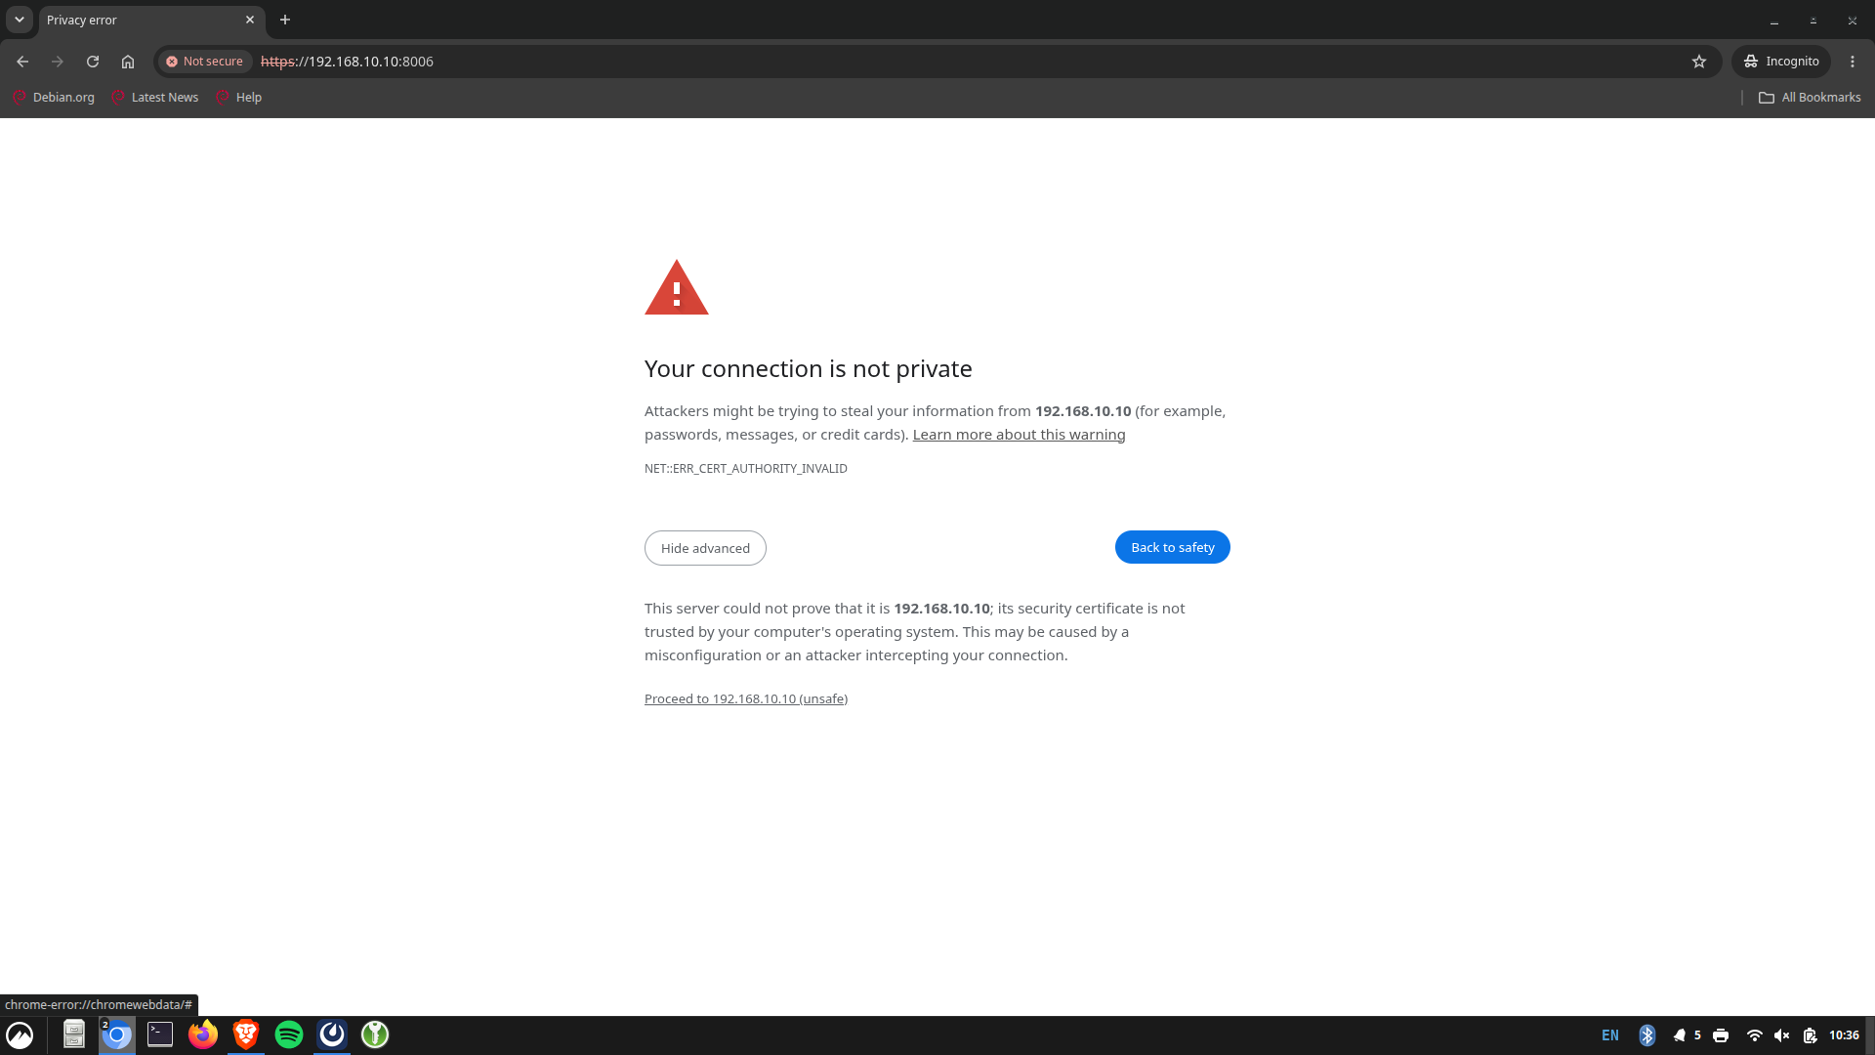

Slide 13
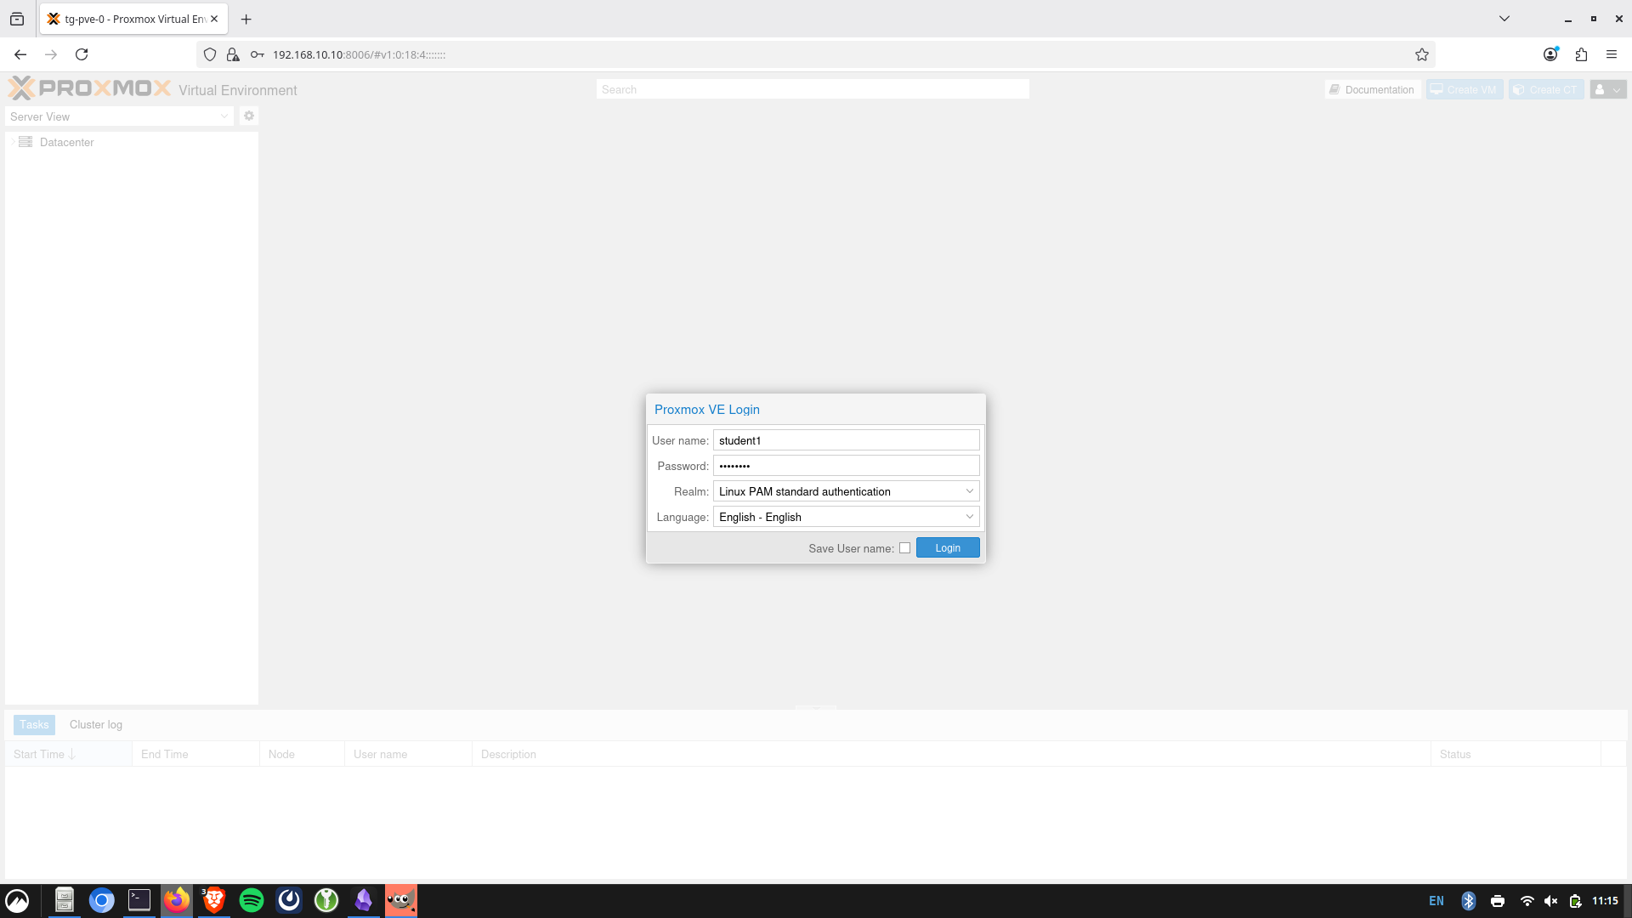
Everyone's username and password will be handed out and be student# where # is assigned to you
student1
Lesson 1

Slide 14
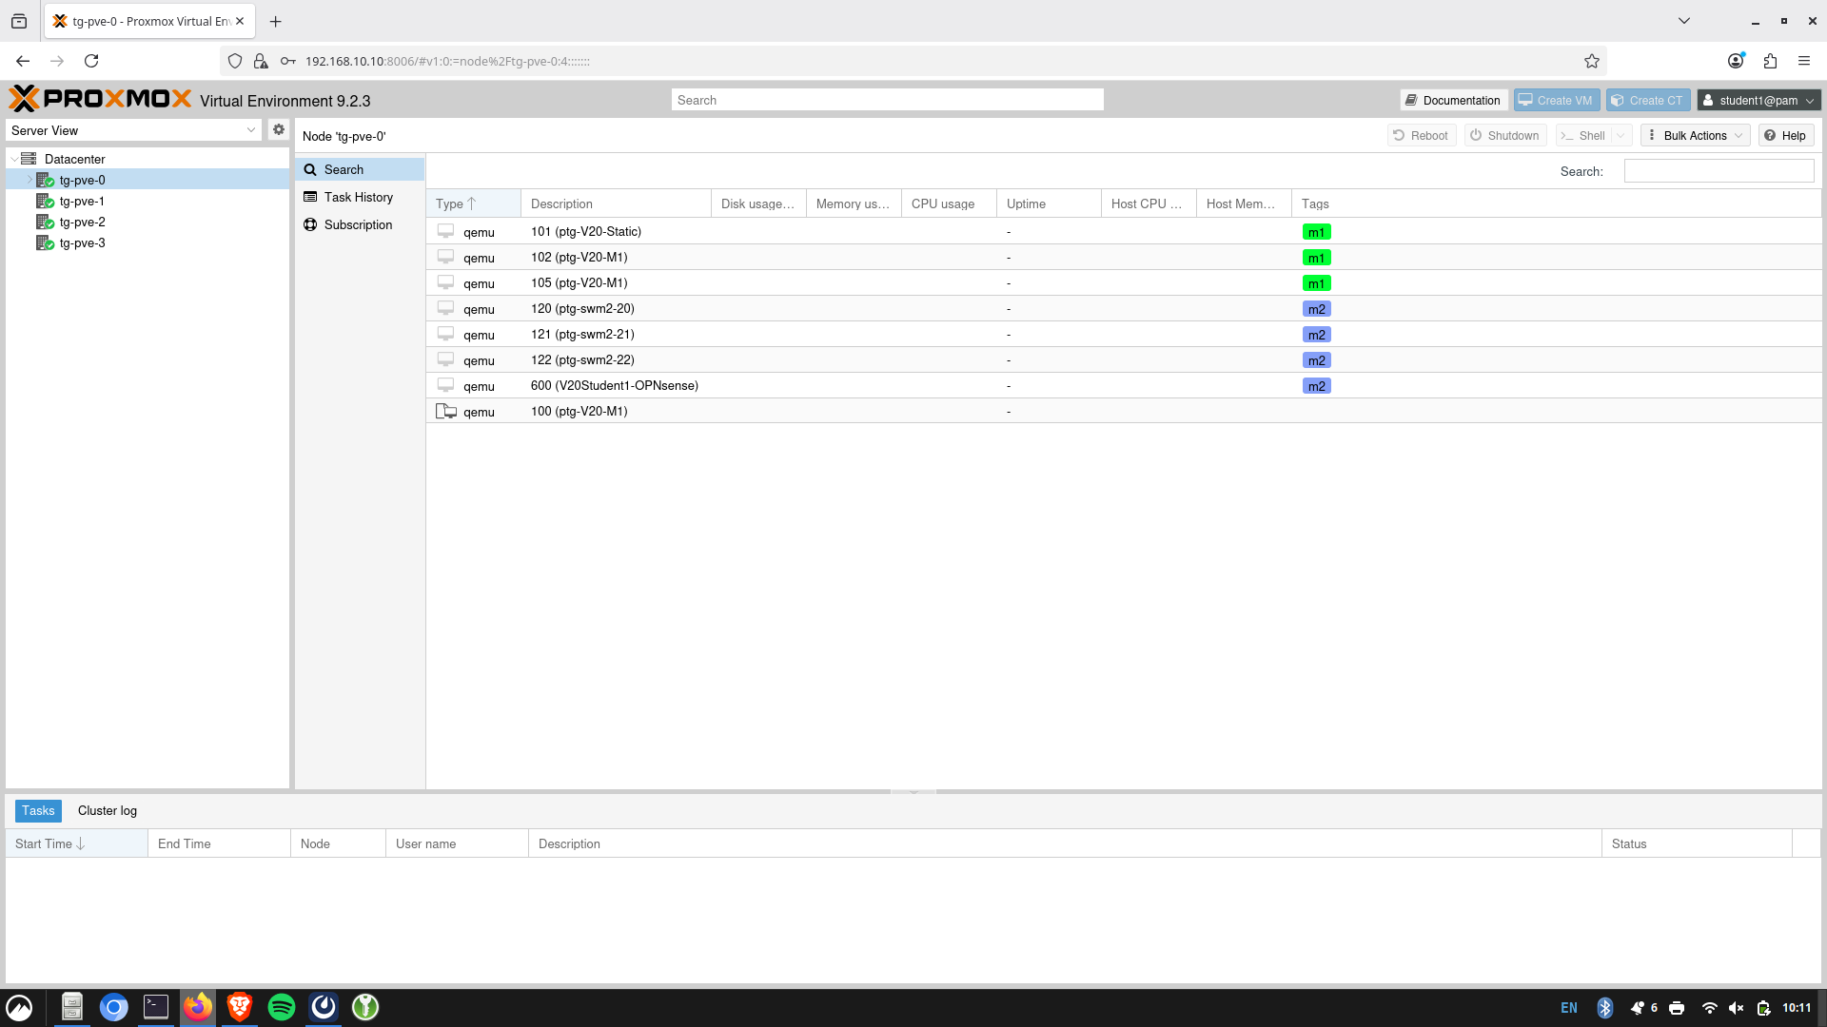
​tg-pve-0 if you are student 1,
tge-pve-1 if student2
tge-pve-2 if student3
Tge-pve-3 if student4

Slide 15
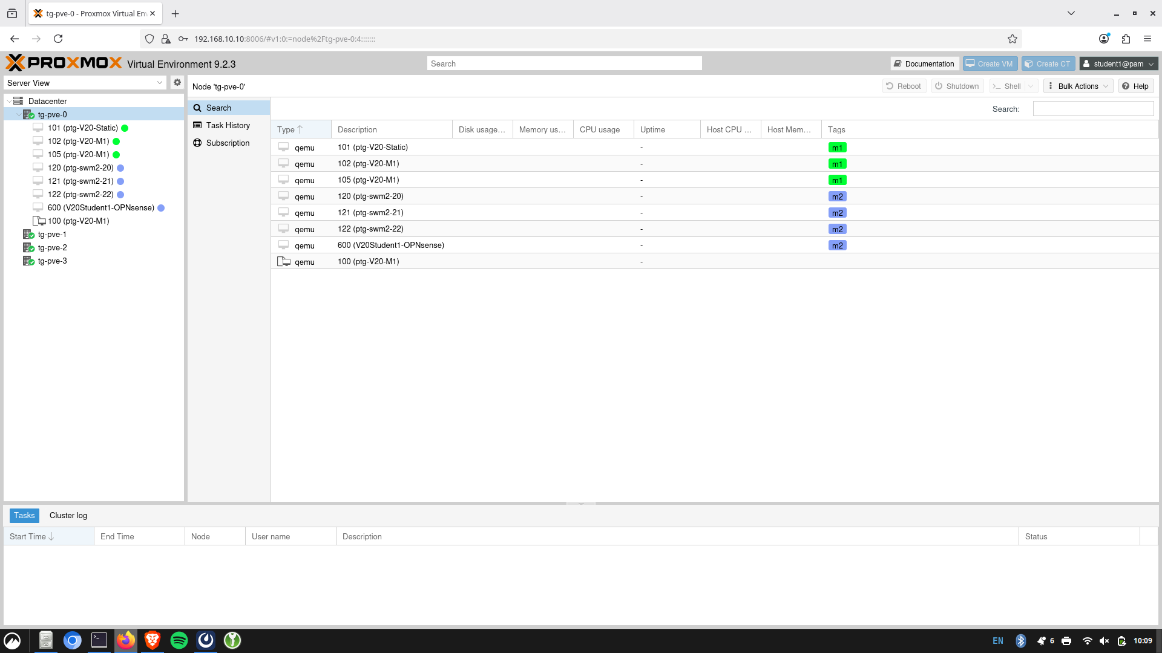
Lesson 1
Notes:
They'll click on tg-pve-0 and this should come up. They will be on the VMs names ptg-V20-M1

Slide 16
Student | VM ID
Tendai | 101
Kyle | 102
Michael | 105
We will pass out sheets with your username, password, and VM for this part.
Lesson 1

Slide 17
Student | VM ID
Tendai | 101
Kyle | 102
Michael | 105
StudentName | 108
StudentName | 109
StudentName | 110
StudentName | 111
StudentName | 112
StudentName | 113
StudentName | 114
TBD​ TBD​
We will pass out sheets with your username, password, and VM for this part.
Lesson 1

Slide 18
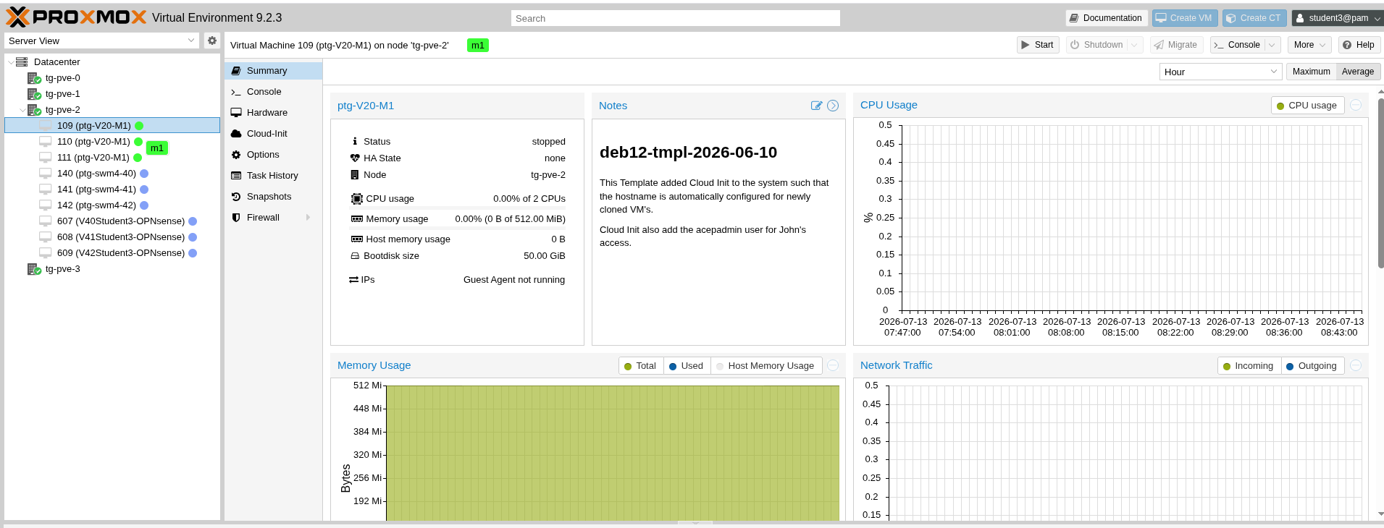
2
3
1
1. Press "start" in the top left corner, and once your VM has a green checkmark next to its name, press "console".
Lesson 1

Slide 19
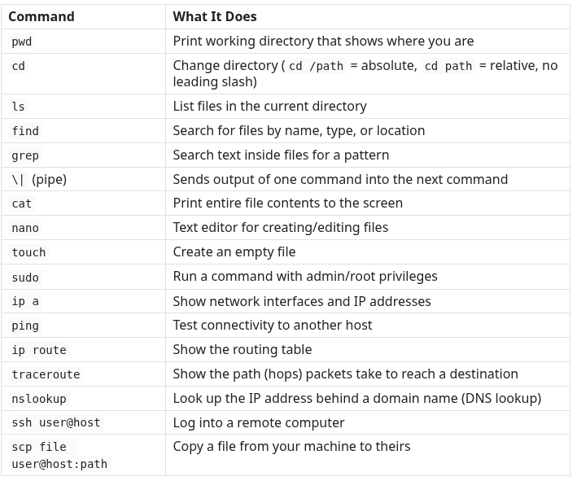
Out Your Linux Cheat Sheets
Lesson 1

Slide 20
Linux Command Line Practice
Demonstration in terminal. Please follow along!
Lesson 1
Notes:
echo, pwd, everything in the test sheet, ipv4 insstead of ipv6 after going over the device ames and localhost and making a directory, touch file then catting it after and before a nano edit, echoing it, pipe and grep, then ip a last!!! -a is all, -l is long
Sudo apt update: sudo is superuser do, apt is advanced package tool; update and upgrade theiur coputers as second to last thing. Then show sudo systemctl restart networking
Last: ip a
Show me logging into their computers with SSH and downloading a file from mine to theirs
The / in CD means starting from root dir

Slide 21
What is binary?
Binary and decimal are two ways of counting.
Computers store and transmit their info in binary (base-2)
Computers read your IP address, packet information, etc. in binary
This is how your online internet address is configured (IP Address)
Lesson 2

Slide 22
Decimal (Base 10s)
Digits: 0, 1, 2, 3, 4, 5, 6, 7, 8, 9
Example:
4285 = 4285₁₀ = (4x10³) + (2x10²) + (8x10¹) + (5x10⁰)
= 4000 + 200 + 80 + 5
= 4285
Lesson 2

Slide 23
Base 2 (Two) - Binary
Digits: 0,1 (binary digits -> bits)
Example: Binary number 1101
Convert to decimal:
0b1101 = 1101₂ = (1x2³) + (1x2²) + (0x2¹) + (1x2⁰)
= 8 + 4 + 0 + 1
= 13
What is the highest number we can represent with 8 bits? 0bx1111 1111?
Lesson 2

Slide 24
What number is 0bx0001 0101
Lesson 2
Notes:
21

Slide 25
IPv4 (Internet Protocol)
How the internet recognizes your computer
Lesson 2

Slide 26
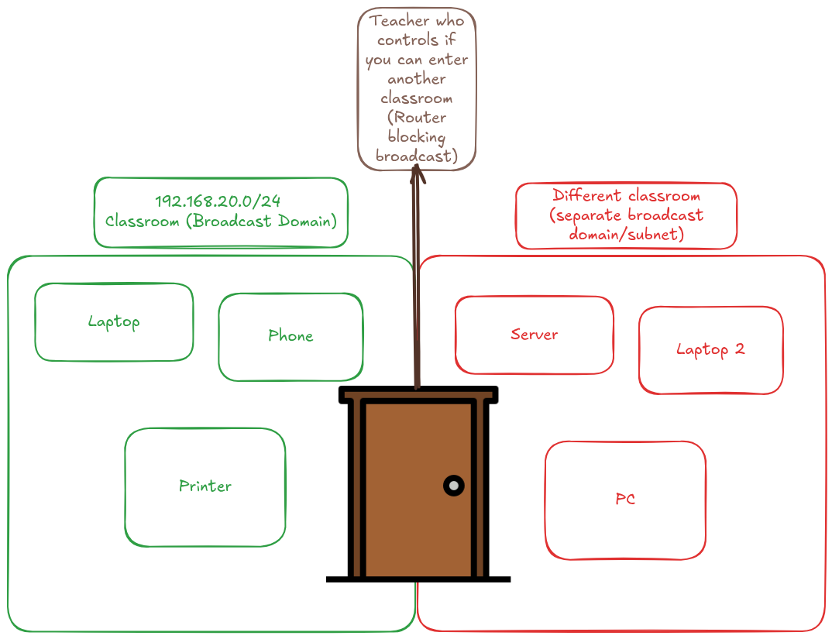

Slide 27
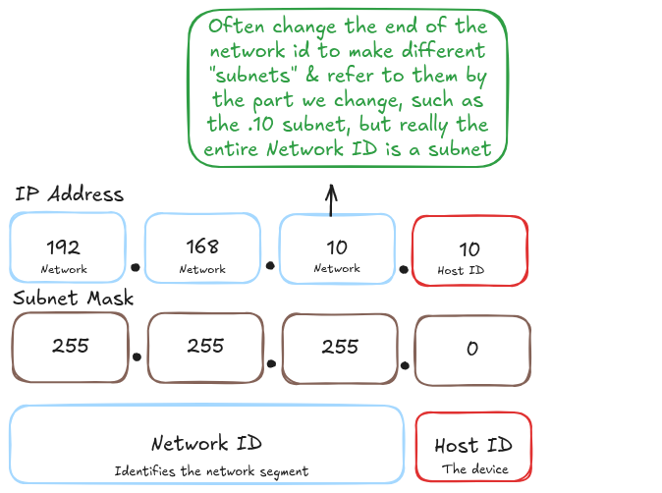
Example IP
Subnets are like rooms!!!
8 bits per section
This is a 24 bit subnet mask; 8 bits left for devices on this subnet
Lesson 2
Notes:
Subnets, broadcast domains, and LANs are all referring to the same thing; same range
Mention the max range is 255
Talk about the structure of subnet vs host device

Slide 28
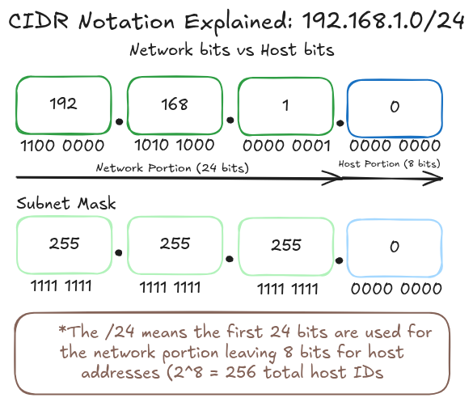
Lesson 2

Slide 29
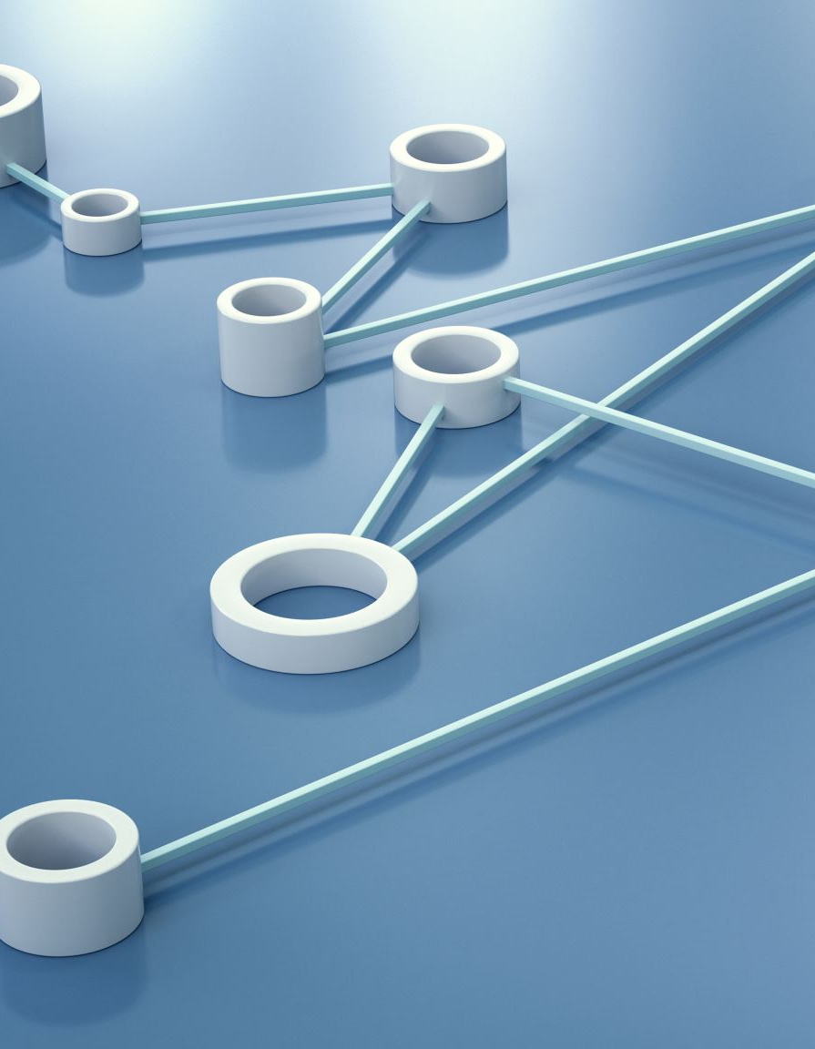
Information Transfer
When you send online information, it goes to a subnet
Routers keep tables of where to send info based on network ID, not host addresses
What issues arise if routers used host ID's instead?
Lesson 2
Notes:
-Issues: needing entry for each device is unscalable, security concerns of kowing IPs, etc.

Slide 30
Which of these are valid IP addresses?
192.168.372.56
186.95.15.12
Because 8 bits make up each of the 4 sections of numbers separated by dots, the maximum range is 0-255 for each section (0000 0000 to 1111 1111)
Lesson 2

Slide 31
Internal vs External IPs
External (public)
Globally unique
Routable across the public internet
Assigned by ISPs
Internal
Used inside your own network
Not routable on public internet
Network address translation (NAT): your router swaps addresses at the edge, so every internal device shares the router's IP, so their own IP and MAC are hidden
Lesson 2

Slide 32
Broadcast Domain
A broadcast is a message one device sends to everyone on the same network subnet
All devices in our example of the 192.168.20.xxx are all in the same room
Routers doors/walls
Smaller rooms stop devices from hearing yells that aren't meant for them
Room analogy and broadcast domain, ex. ip a
Lesson 2
Notes:
Same range as subnet, lan. Router is like a door

Slide 33
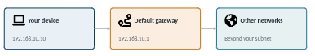
Gateway IPs
Connects your LAN to everything else
Inbound/Outbound traffic goes through the gateway first
No gateway = local traffic still works, but nothing further
Usually on a .1 subnet; 192.168.20.1
Lesson 2
Notes:
Often the router, and as a DHCP service often.
Use door analogy
Image is from AI

Slide 34
Setting our own IPs statically
Lesson 2
Notes:
Discuss static vs dynamic IPs briefly but we will get more into that with DHCP section
They need proxmox because they will need console access when they reset IPs, so if they tried to WSSH it would kick them out and we don't want to deal with that

Slide 35
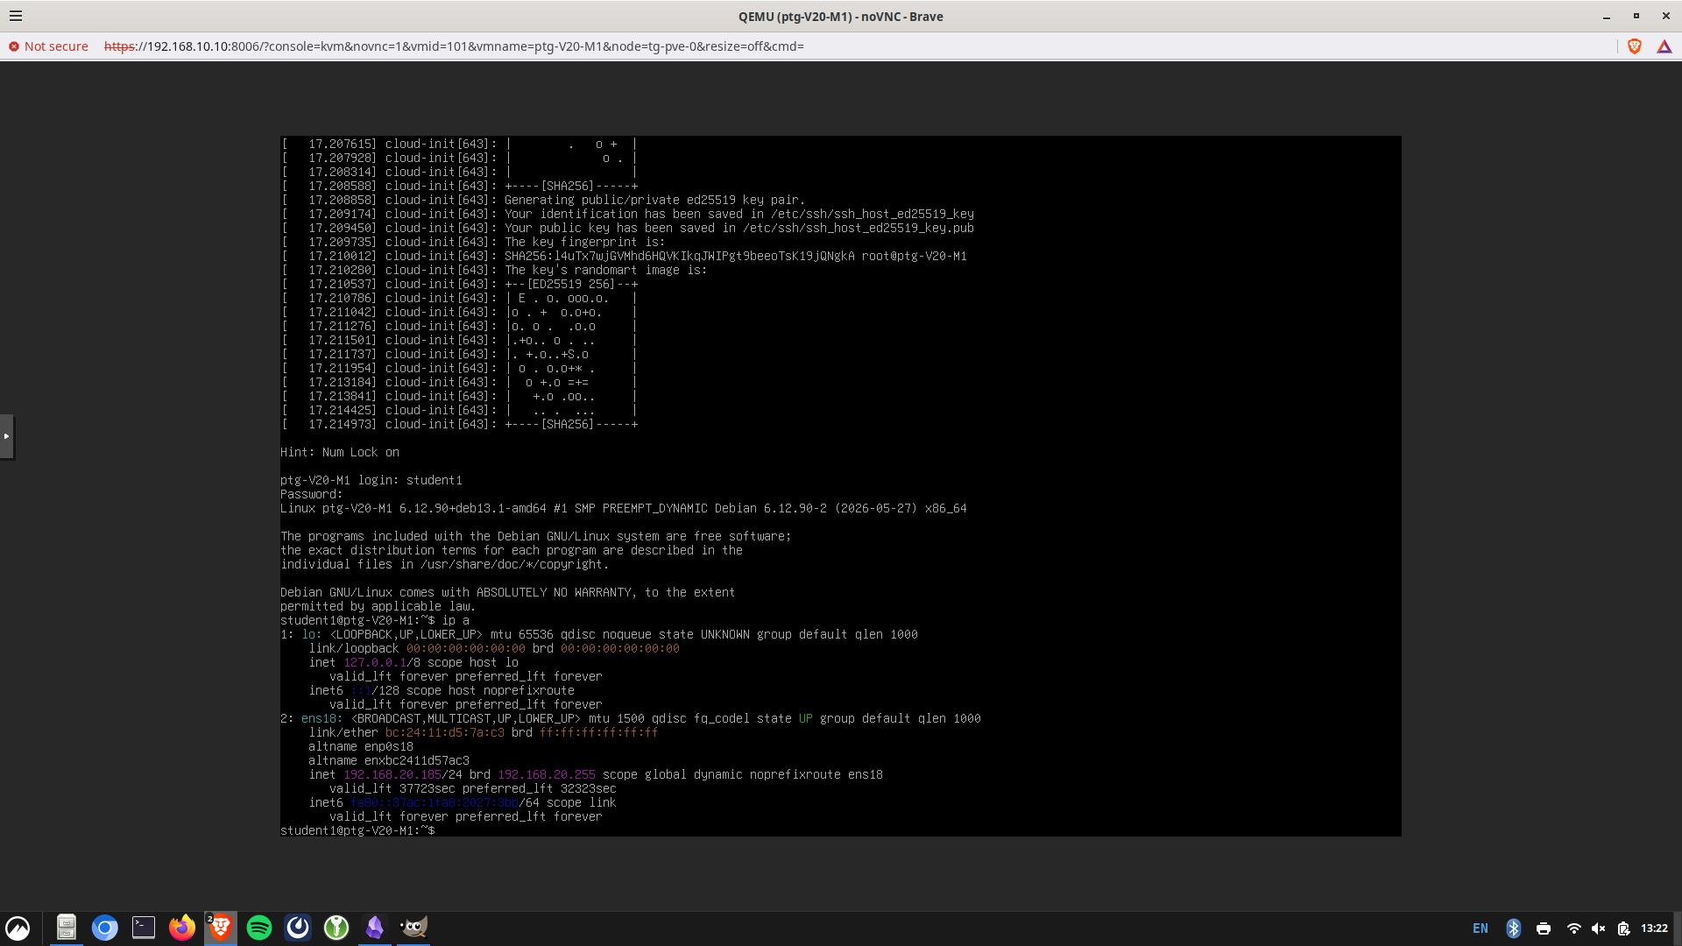
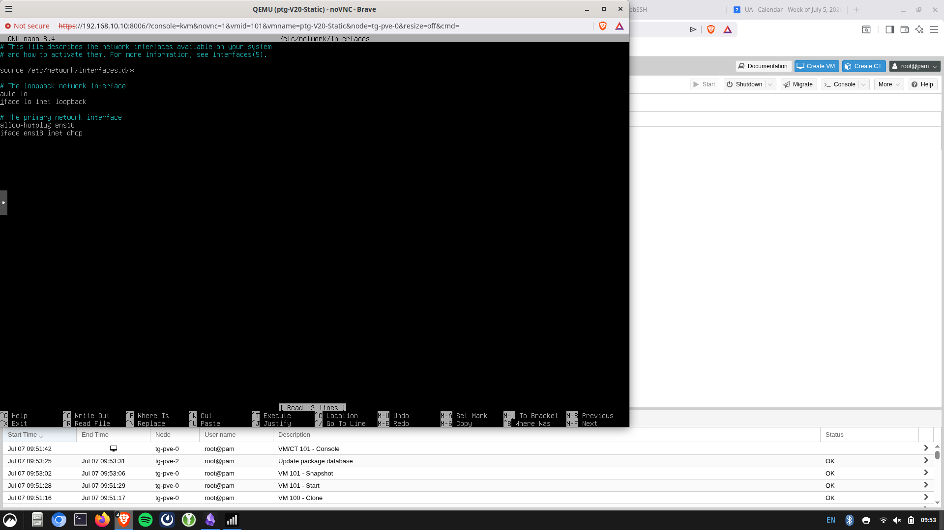

sudo nano /etc/network/interfaces
Lesson 2
Notes:
Have someone raise their handa nd tell me their ip address
Need to do sudo because the file path is within our root user, not other one
1. Use the "ip a" command we went overearlier. Notice that you already have an IP.But, nobody set it, so we must be getting itautomatically (a process called DHCP wewill go over next section)
2. We are going to change it so that it isn'tautomatically set to some randomnumber, but to a specific one we want.
3. We will now use the command "sudonano /etc/network/interfaces. This is toedit how our network gets our IP address.

Slide 36
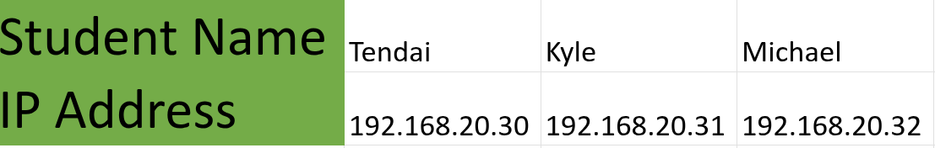

Raise your hand once it is typed I will check your file
To exit and save, type: "Ctrl+X" ->"y" ->"enter" button
Type: sudo systemctl restart networking
Type ip a
Lesson 2
Notes:
WSSH issue if we change the ip 1. We have two different images below. What're the differences between what they are saying?
2. Find your IP you will statically set in the table above.
3. Edit the text in the file to be like the second image, but where it says "address" fill in your IP from the table instead. ANYWHERE ITSAYS ENS## DO NOT CHANGE IT.
4. After you edit the file, check it with a partner. Then, press "Ctrl+X"->"y"-> "enter"
5. Type "systemctl restart networking"
6. Try the "ip a" command again. What is your ip? What is your neighbor's?

Slide 37
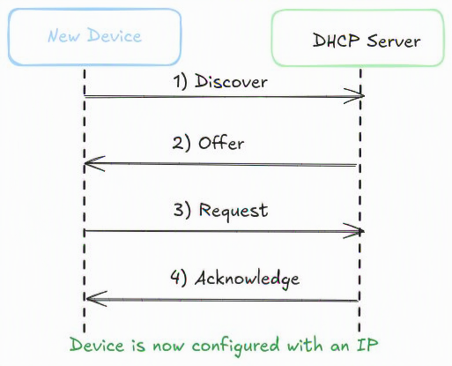
DHCP (Dynamic Host Configuration Protocol)
Restaurant waiter giving you a table
DHCP is how a device automatically gets an IP address
Without the address, information doesn't know where to go
Range, Lease
DHCP Address collision
Lesson 3
Notes:
Address collision: can happen if youstatically assign an IP in the DHCP range, or if 2+servers try to give the same address to a device
Range: Talk about waiter analogy more and also the usual range,lease talk about it running out, and how the device will keep that lease for 12 hr :ibrary book analogy works well too

Slide 38
DHCP Ranges Visual - GLiNet
Lesson 3

Slide 39
Why may we want a DHCP address instead of statically assigning each device?
Lesson 3

Slide 40
Rollback, Re-login
Lesson 3
Notes:
Last minute issue: When switching back to dhcp it also keeps the static one. Restarting networking service doesn't fix, and the presentation is in 30 minutes so I am just going to roll everyone back and fix later.

Slide 41
Raise your hand once it is typed I will check your file
To exit and save, type: "Ctrl+X" ->"y" ->"enter" button
Type: sudo systemctl restart networking
Type ip a
Lesson 3
Notes:
1. We have two different images below. What're the differences between what they are saying?
2. Find your IP you will statically set in the table above.
3. Edit the text in the file to be like the second image, but where it says "address" fill in your IP from the table instead. ANYWHERE ITSAYS ENS## DO NOT CHANGE IT.
4. After you edit the file, check it with a partner. Then, press "Ctrl+X"->"y"-> "enter"
5. Type "systemctl restart networking"
6. Try the "ip a" command again. What is your ip? What is your neighbor's?

Slide 42
If DHCP randomly assigns an IP from within a range, why is it the same as before?
Lesson 3
Notes:
Let them guess then go to next slide
The term Media Access Control (MAC) originates from the historical split of the Data Link Layer into two sublayers: the Logical Link Control (LLC) and the Media Access Control (MAC) sublayer. The name was chosen to distinguish the bottom sublayer’s specific function—controlling access to the physical transmission medium—from the top sublayer’s role in forming logical links

Slide 43
Explanation...
DHCP leases vs new per connection
Within lease time, DHCP tries to give it the same IP if available
How does this stabilize the network?
Unavailable IP = DHCP assigns another within its range​
Library book return policy
Lesson 3
Notes:
If trying to get same book after returning, it may be back, or they may have a different copy ecause soeone else got the book
Stabilizes: Not always chaning identities/IPs for devices

Slide 44
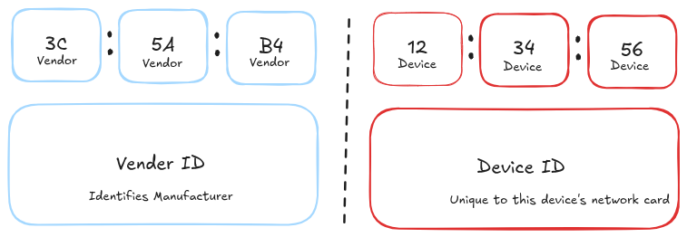
MAC (Media Access Control) Address
A MAC address is like a serial number burned into a device's physical chip
Written as 6 pairs of hexadecimal characters (e.g. 3C: 5A: B4: 12: 34: 56)
First half identifies manufacturer, second half is unique to device
Unlike IP address, never changes no matter what network you join
Only matters on your local network segment; devices outside your subnet never see it directly because the routers mask it
Lesson 3

Slide 45
What is hexadecimal?
Base 16
Used for a MAC address
Physical address of the computer
More efficient way to show binary numbers
1 Digit in hexadecimal is four digits (a byte) in binary
Lesson 3

Slide 46
Base 16 - Hexadecimal
Digits: 0, 1, 2, 3, 4, 5, 6, 7, 8, 9, A, B, C, D, E, F
Example: "A5"
Convert to decimal:
0xA5 = = A5₁₆ = (10x16¹) + (5x16⁰)
= 160 + 5
= 165
Lesson 3

Slide 47
What number is 0x004A
Lesson 3
Notes:
74; 64 + 10

Slide 48
Checking our MAC addresses
Lesson 3
Notes:
Ip a

Slide 49
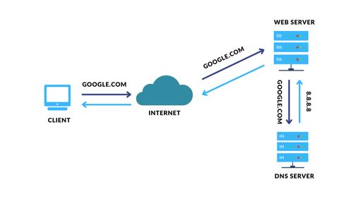
DNS (Domain Name System)
The internet's address book
Like Google Maps
Your device will ask a "resolver" (often run by your ISP)
If resolver doesn't know, it asks up a communication chain
Once IP is given, browser connects
Google.com vs IP
Lesson 3
Notes:
If they know phonebooks use that analogy. Also, Google maps analogy: you put in the name, computer returns address
Public resolver is 8.8.8.8
Picture source: https://www.itjones.com/blogs/understanding-dns-basics-of-computer-networking

Slide 50
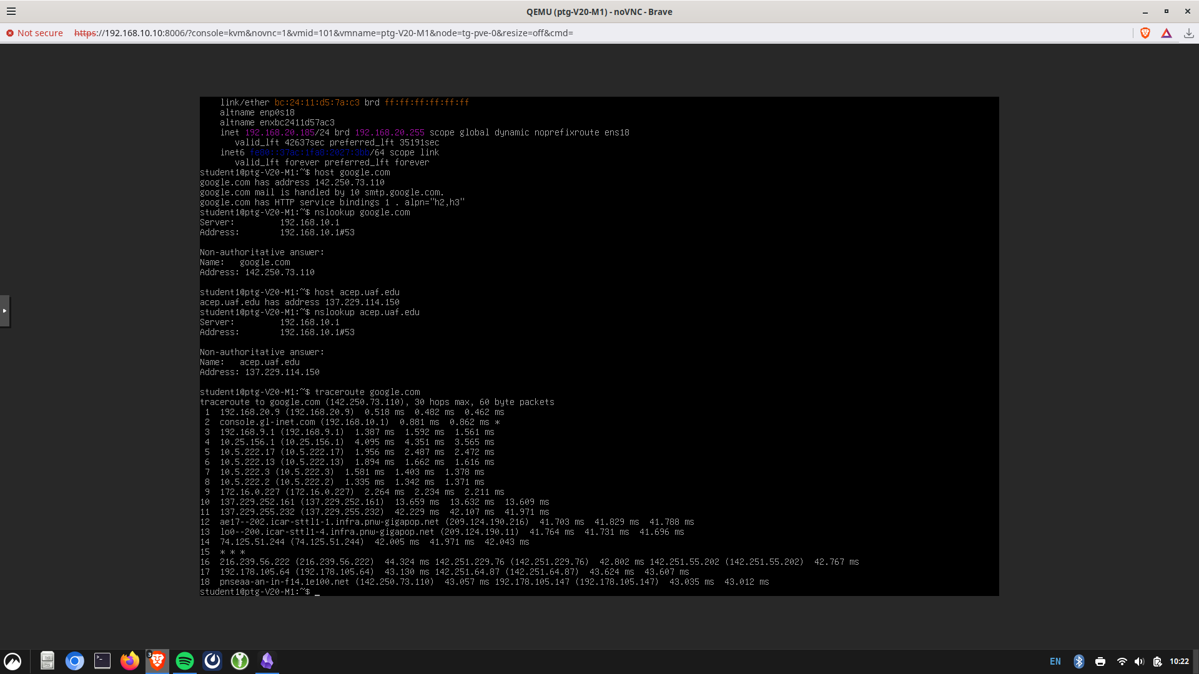
We can see the translation and the route being taken in real time
Type "host google.com" and "nslookup google.com"
What are they doing?
Lesson 3
Notes:
Can use the uaf.acep.edu address too
The gateway is not the DNS server in this case. If they know phonebooks use that analogy. Also, Google maps analogy: until you put in the name, you don't get the address from your phone.

Slide 51
We can see the translation and the route being taken in real time
Type "host google.com" and "nslookup google.com"
What is it doing?
Try both these commands with "acep.uaf.edu" instead of google.com. What do you notice?
DNS lookup being resolved
Lesson 3
Notes:
Can do with uaf.acep.edu too
This is translation portion
Phonebook/google maps name to address transaltor

Slide 52
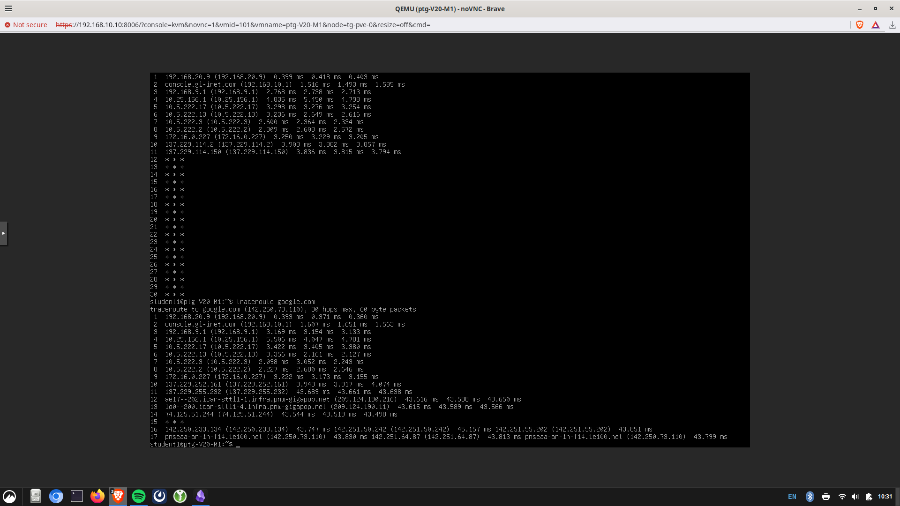
We can see the translation and the route being taken in real time
Type "traceroute google.com"
Lesson 3
Notes:
Router is teacher going to dif rooms Show internal to external is 172 to 137 Shows the route your data takes toreach a website by listing eachnetwork hop (router) along the way.
Measures response time to eachhop, helping identify where delaysoccur.
Uses increasing values so eachrouter reveals itself one at a time.
May show * * * or fail if a router orfirewall blocks or ignores tracerouterequests, even if the destination is stillreachable.

Slide 53
We can see the translation and the route being taken in real time
Type "traceroute acep.uaf.edu"
Lesson 3
Notes:
Shows the route your data takes toreach a website by listing eachnetwork hop (router) along the way.
Measures response time to eachhop, helping identify where delaysoccur.
Uses increasing values so eachrouter reveals itself one at a time.
May show * * * or fail if a router orfirewall blocks or ignores tracerouterequests, even if the destination is stillreachable.

Slide 54
10 Minute Break

Slide 55
NTP (Network Time Protocol)
NTP is how devices agree what time it is.
Why might this be important?
Time comes from a small number precise reference clocks
Your device asks a local timeserver, then matches its clock
Lesson 4
Notes:
There is more but that is all they should know for now. It's like a game of telephone with time getting less accurate between servers from og source.
Instructed not to discuss stratum much if at all

Slide 56
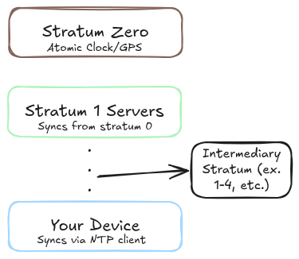
NTP (Network Time Protocol)
NTP is how devices agree what time it is. Why might this be important?
Time comes from a small number of very precise reference clocks
Those precise sources feed a layer of servers (layer = stratum), which feed everyone else in a tree-like hierarchy
Your device asks a nearby local timeserver, then changes its own clock to match
Each successive stratum is less accurate
14 * * * 15 * * * 16 * * * 17 * * * 18 * * * 19 * * *
14 * * *
15 * * *
16 * * *
17 * * *
18 * * *
19 * * *
Lesson 4

Slide 57
Testing!
Type in "date"
What do you notice?
Lesson 4
Notes:
Show next slide if it is a few minutes off.

Slide 58
Where is it getting this delayed time info from?
Discuss with a partner
Lesson 4

Slide 59
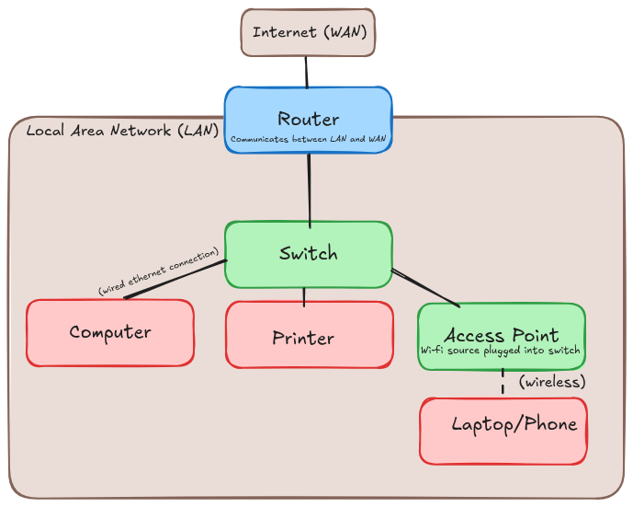
LAN (Local Area Network)
Classroom; what is each part
A LAN is a network confined to one physical space
Devices have wired or wireless connections
Router handles edge communication
WAN vs LAN; multiple LANs
Note: A VLAN is a virtual LAN defined to keep traffic separate without need for extra hardware. I did this for your training ground through managed switches, which work on layer 3 of the OSI
Lesson 4
Notes:
Only take analogy as far as it will go. A switch is like a classroom getting more students assigned to your class. Other LANs, router, computer/devices = easy. Wireless vs wired lol don't use analogy. Router talk about WAN/LAN connection and NAT. Show the connections between acces point and switch directly

Slide 60
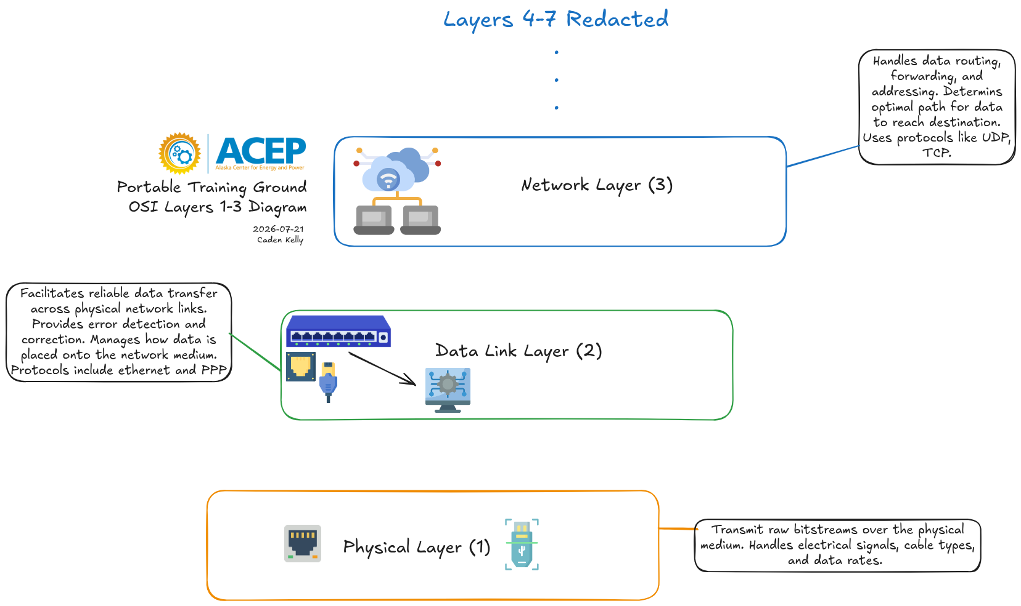
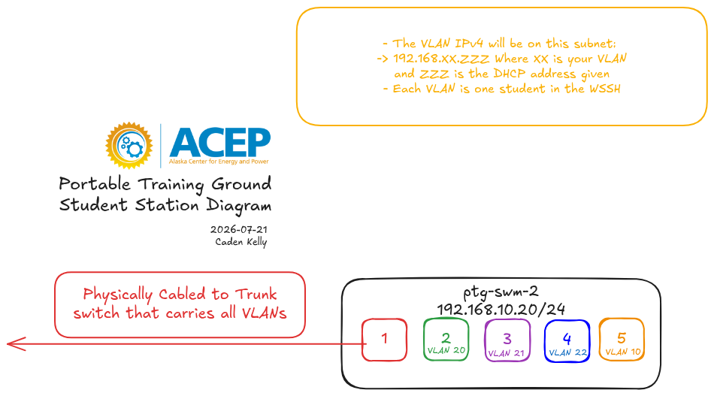
Handouts!
Lesson 4
TBD​ TBD​

Slide 61
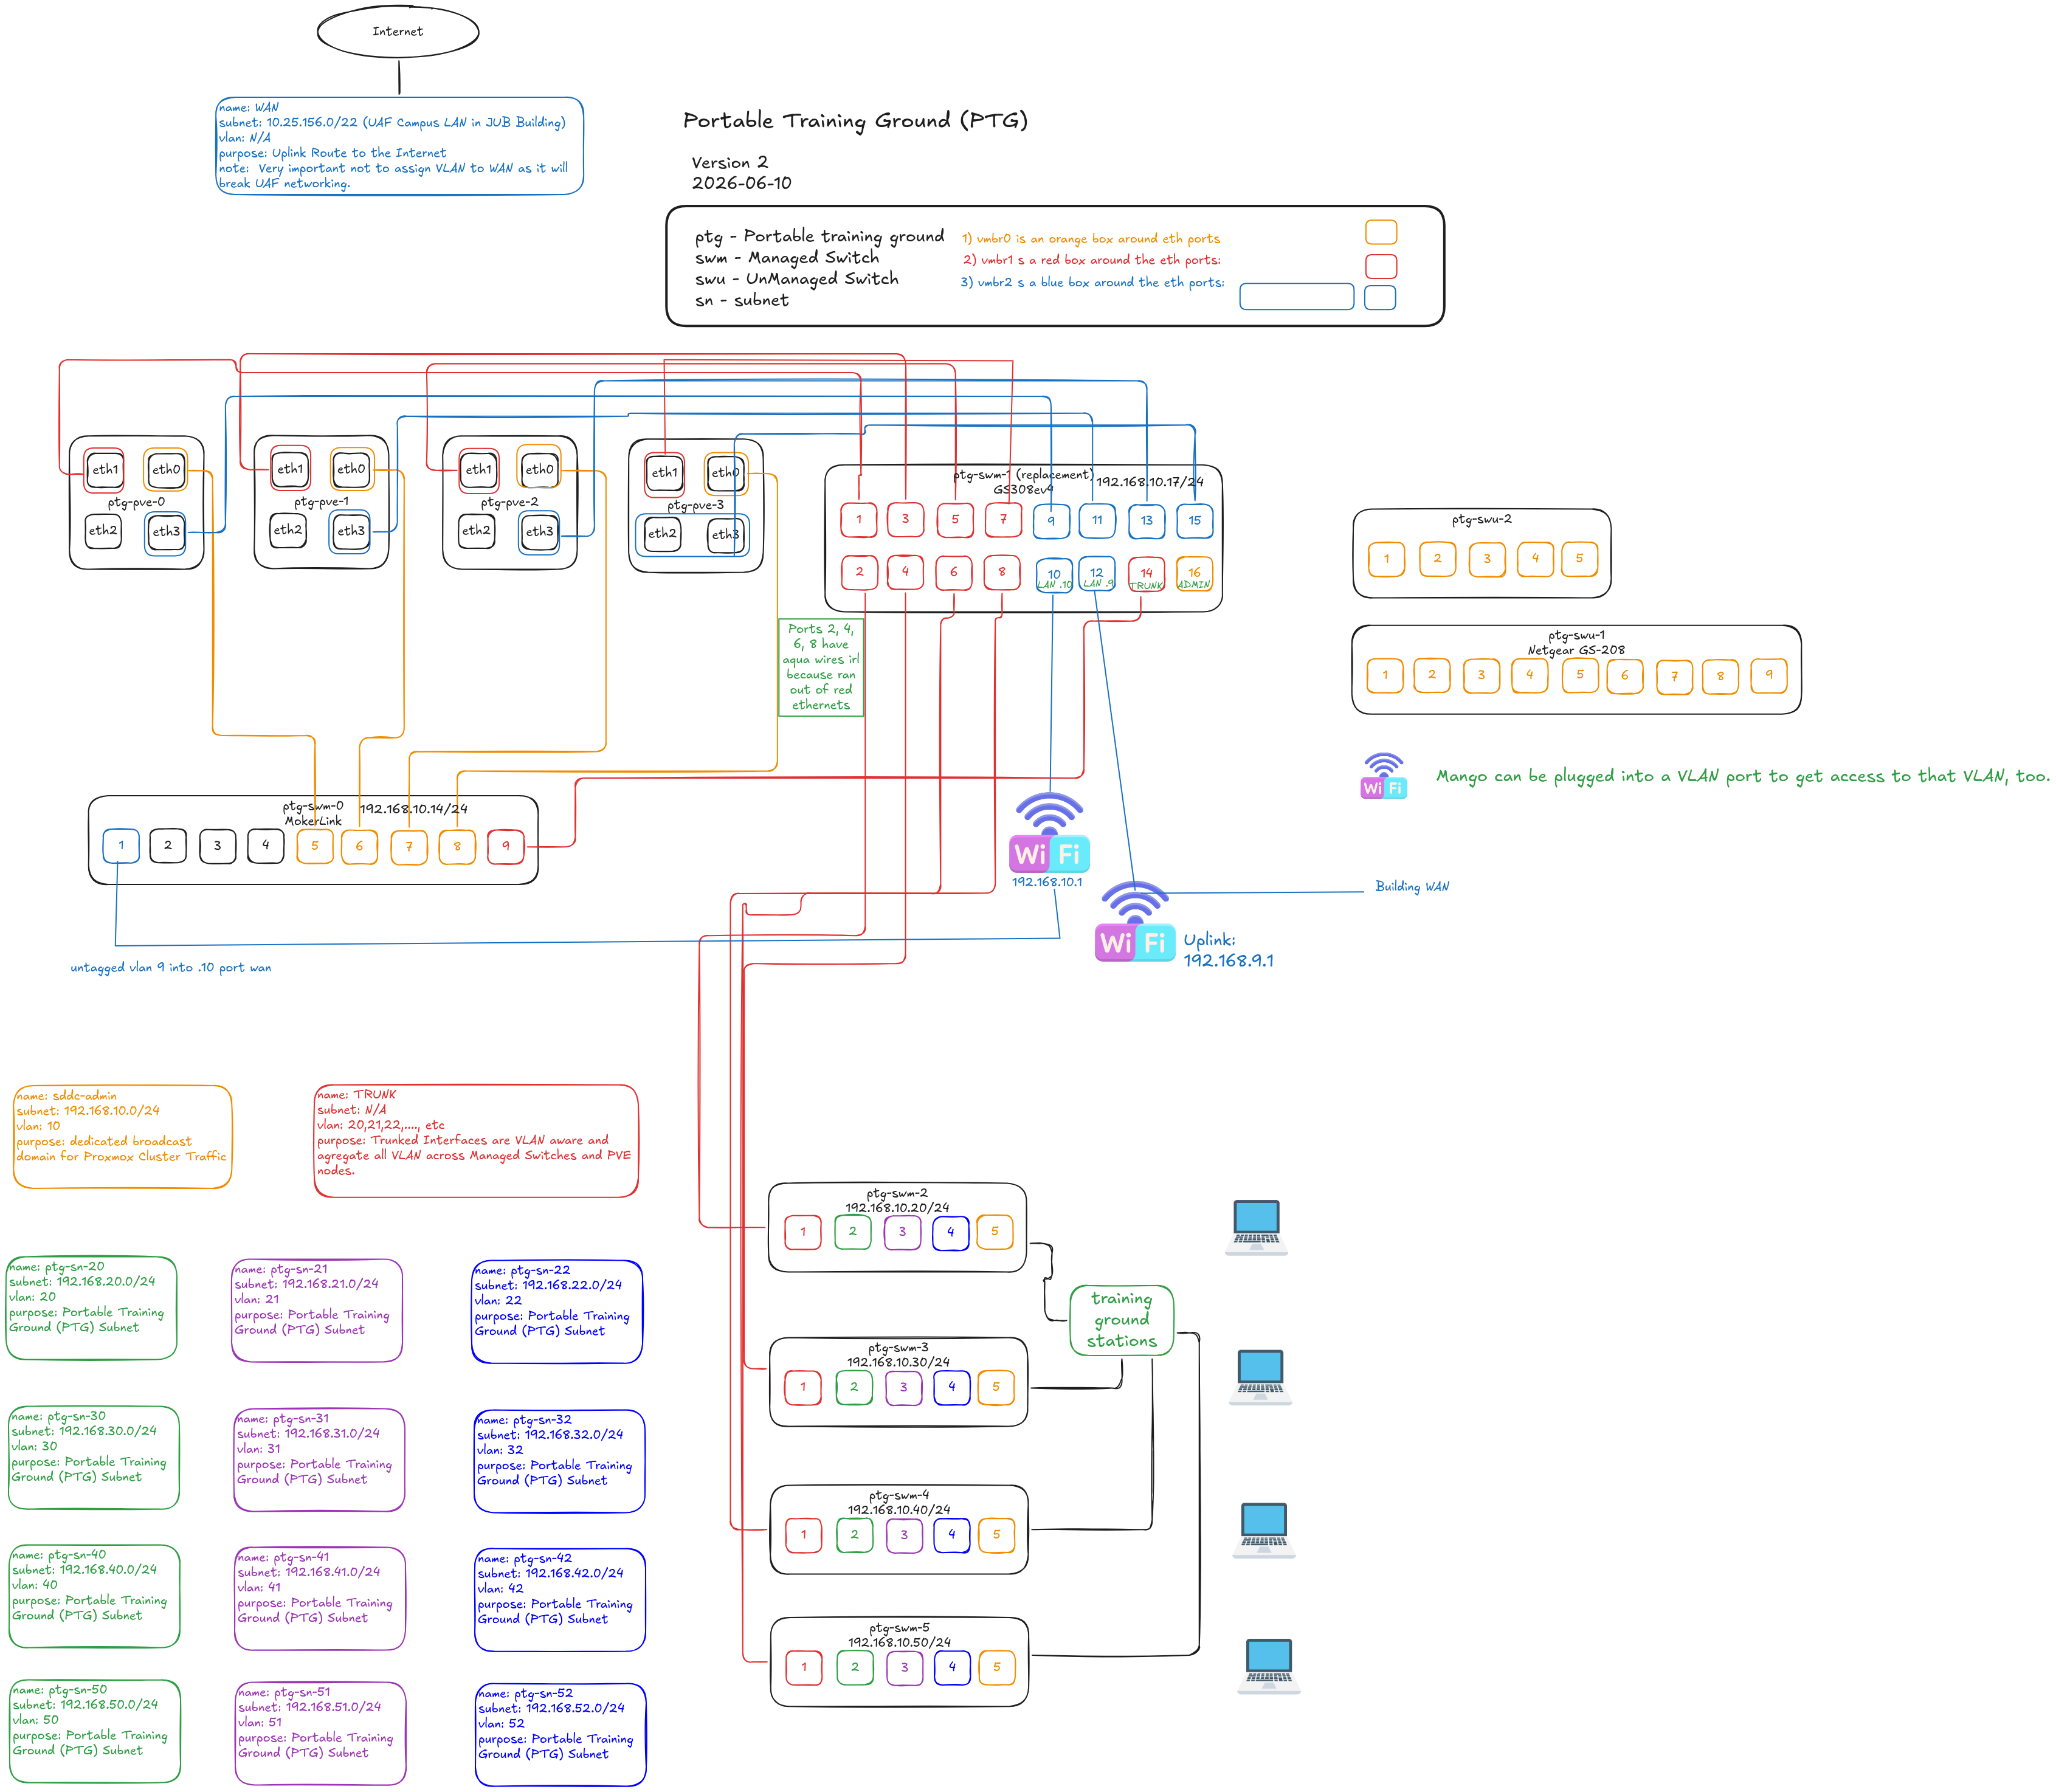
Lesson 4

Slide 62
Physical Training Ground "Tour"
Come up to the training ground
We will only be focusing on OSI layers 1-3
Managed vs unmanaged switches
Why do we have so many different LANs
Lesson 4
Notes:
Tell them to bring their diagrams we passed out up too. nmanaged switches just expand ports for a LAN
Managed switches let you configure, monitor, + secure the LAN. Can have different VLANs on different ports

Slide 63
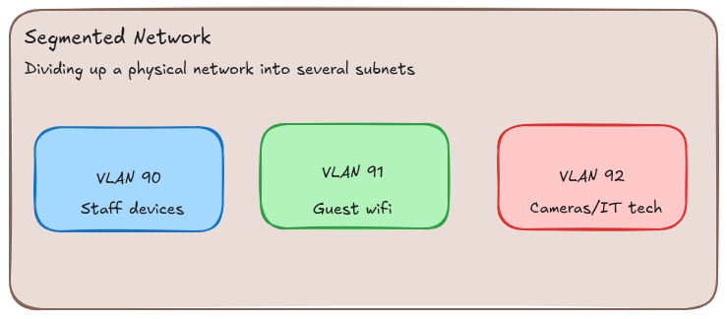
Network Segmentation
Store: cameras vs guests vs employees
Splitting a network into smaller networks
Own subnet and broadcast domain
Used to keep different kinds of traffic apart.
A router decides what traffic is allowed to cross
Lesson 4

Slide 64
Why is this a good idea?
Discuss with a partner then raise hands to answer
Lesson 4
Notes:
Better security (a compromised device can't roam the whole network),
Better performance (smaller broadcast domains) with less traffic to wade through
Easier troubleshooting since you know what smaller subnet the issue comes from
More organized i.e. why have cameras on the same wifi as guests
We will see more of this in our second module - firewalls

Slide 65
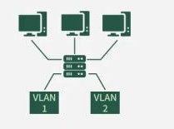
Benefits
Better security
Better performance; less traffic to wade through
Easier troubleshooting
More organized
A focus of our second module - firewalls
Lesson 4
Notes:
Geeksforgeeks.org is image source
Better security (a compromised device can't roam the whole network),
Better performance (smaller broadcast domains) with less traffic to wade through
Easier troubleshooting since you know what smaller subnet the issue comes from
More organized i.e. why have cameras on the same wifi as guests
We will see more of this in our second module - firewalls

Slide 66
Activity Pt. 1
Find someone in your group and try to ping their IP
"ping 192.168.xx.xxx" fill in the x's with their ip information
What do you notice
Get a group member's IP and "traceroute <insert their IP>
What do you notice?
Lesson 4

Slide 67
Logging Into Different Subnets WSSH

Slide 68
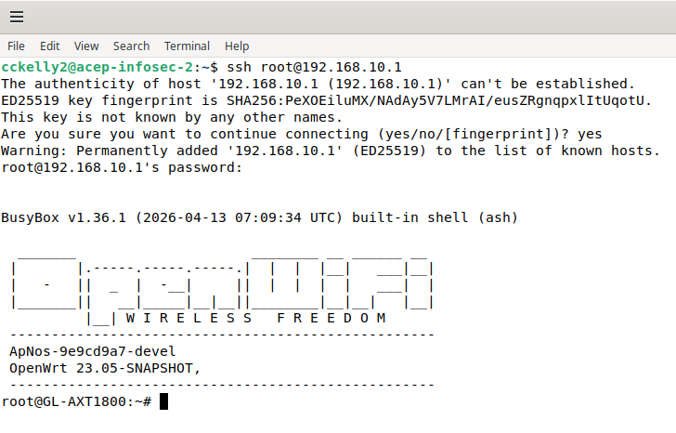
What are SSH (Secure Shell), WSSH?
A service your computer has. Services run on virtual "ports"
Post office/box analogy
Secure remote access tool requiring a login
If allowed you can log into the root (administrative) terminal of another computer
WSSH is a public software allowing you to do this through a web browser (Web-SSH)
Lesson 4
Notes:
Good: Own computer managament from far away if network is running. Bad: Downloading files with malware onto another person's computer. They need to have SSH enabled on their computer, and you ened to know the login/password of an account on the computer for it to work; most have a root account with a dedicated password

Slide 69
WSSH Login
http://192.168.10.219:8888/
Lesson 1
Notes:
The new VMs should already be started up

Slide 70
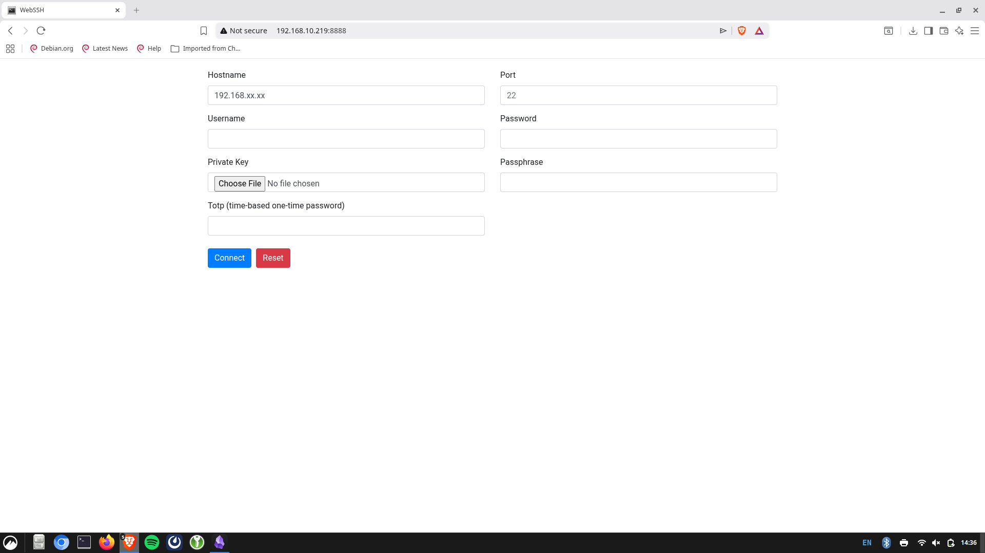
Lesson 1
Notes:
Use for end of M1 network segmentation into a different virtual machine if doing WSSH

Slide 71
Login Directions
Student | Hostname
Tendai | 192.168.20.118
Will | 191.168.21.160
Michael | 192.168.22.104
Filler | 192.168.30.177
Filler | 192.168.31.110
Everyone will have the same username/password as the sheet we gave out earlier
The table shows your hostname to put in next to your name
Fill
Filler | 192.168.32.125
Lesson 1
Notes:
Start > Console
TO WORK: Turn off dhcp vm, then turn on opnsense firewall vm. Have them all do systemctl restart networking
May need to change the ip values to the appropriate ones shown by jump vm/their ip a in the moment; not bad, just you may need to check each

Slide 72
Activity Pt. 2
Find someone in your group and try to ping their new IP
"ping 192.168.xx.xxx"
Get a group member's IP and "traceroute <insert their IP>
What do you notice?
What happened?
Lesson 4
Notes:
Firsst notice: Can't ping on different subnets now:
Second notice: A single router hop away because you're on different VLAN subnets ofthe same router

Slide 73
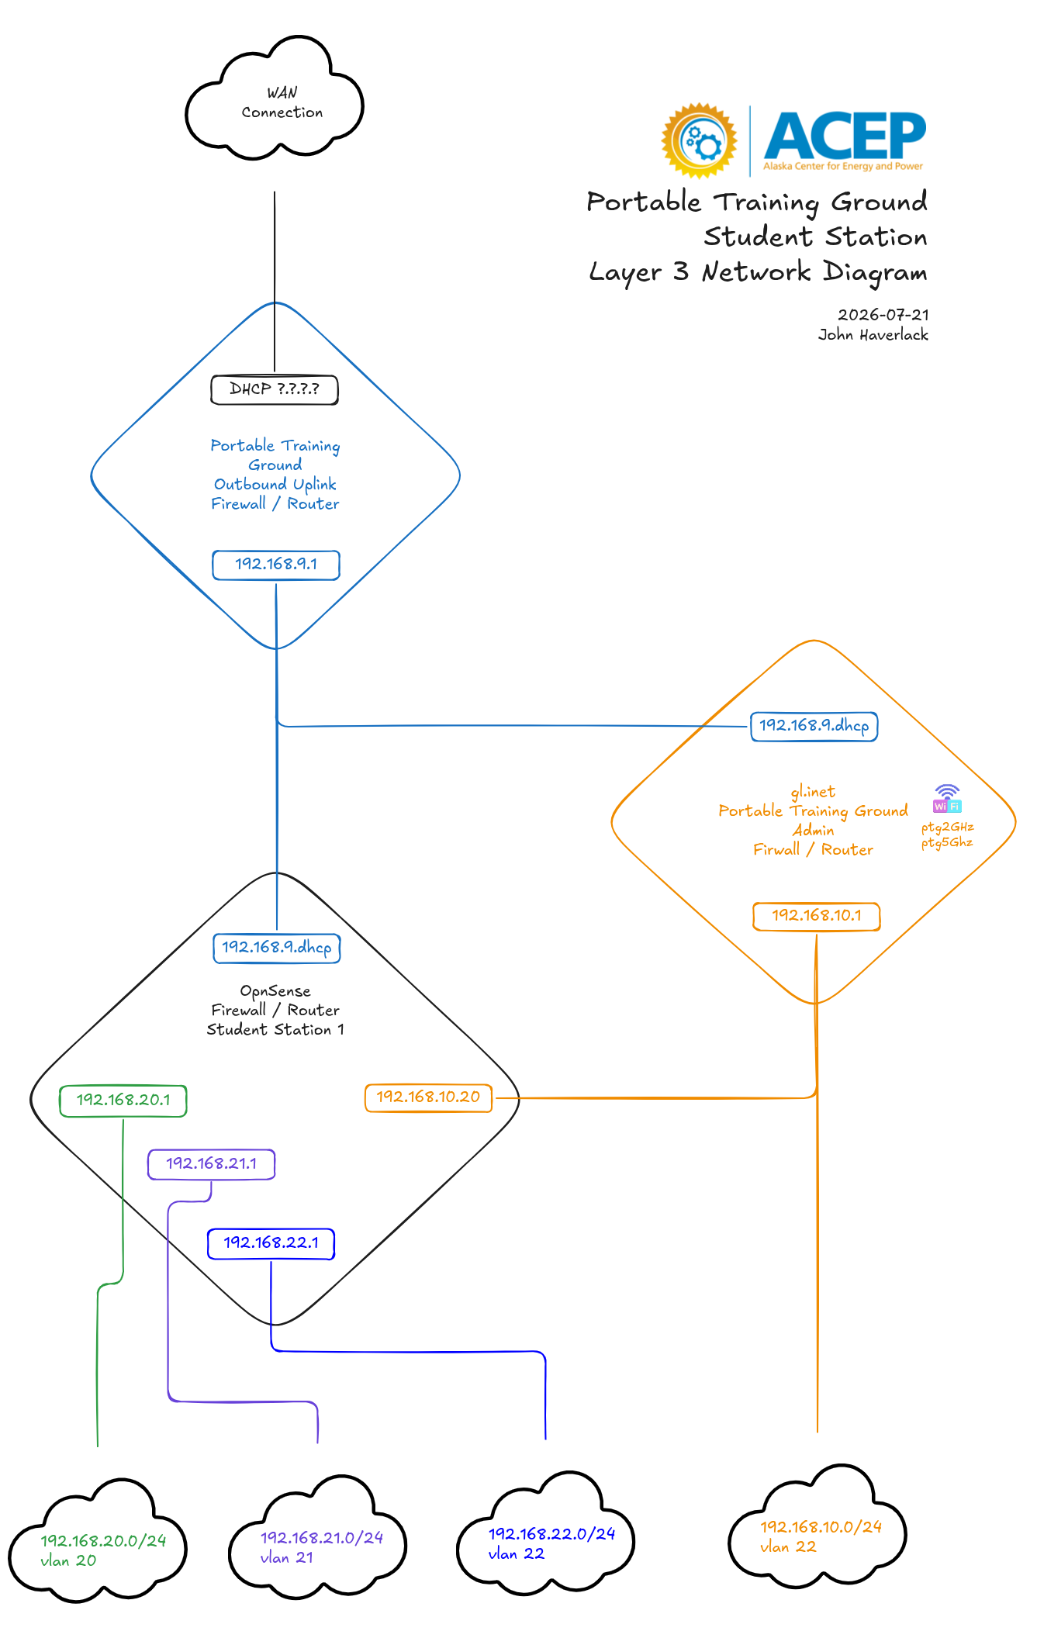
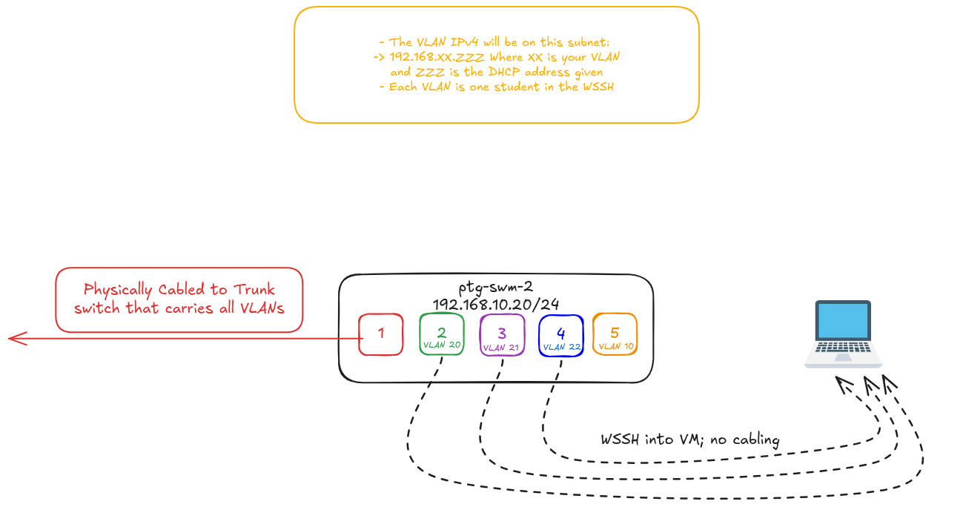
Diagram of Our Networks
What parts can you match on these two diagrams?

Slide 74
Ports/Services
IP is the post office, port is the specific mailbox
Hosts specific computer program
Common ports; 443, 80, 22
Socket connection: Both IP and port connected from sender/receiver
Lesson 4

Slide 75
20 Minute Break

Slide 76
Module 2 Agenda: Firewalls
M2: these are filler times and need to be changed per presentation, however this is intended to be a ~3 hour module.
3:30pm – 4:10pm - What is a Firewall? Diagram Current Network, Get Into OPNsense WUI
4:10pm – 4:20pm - 10 minute break
4:20pm – 5:20pm - Configure VM DHCP, DNS, and NTP, Testing With Chrony and Pings
5:20pm – 6:20pm - Firewall Rules, Configuration, Testing
6:20pm – 6:30pm - Feedback Form, END
TBD​ TBD​
Notes:
DHCP VM off

Slide 77
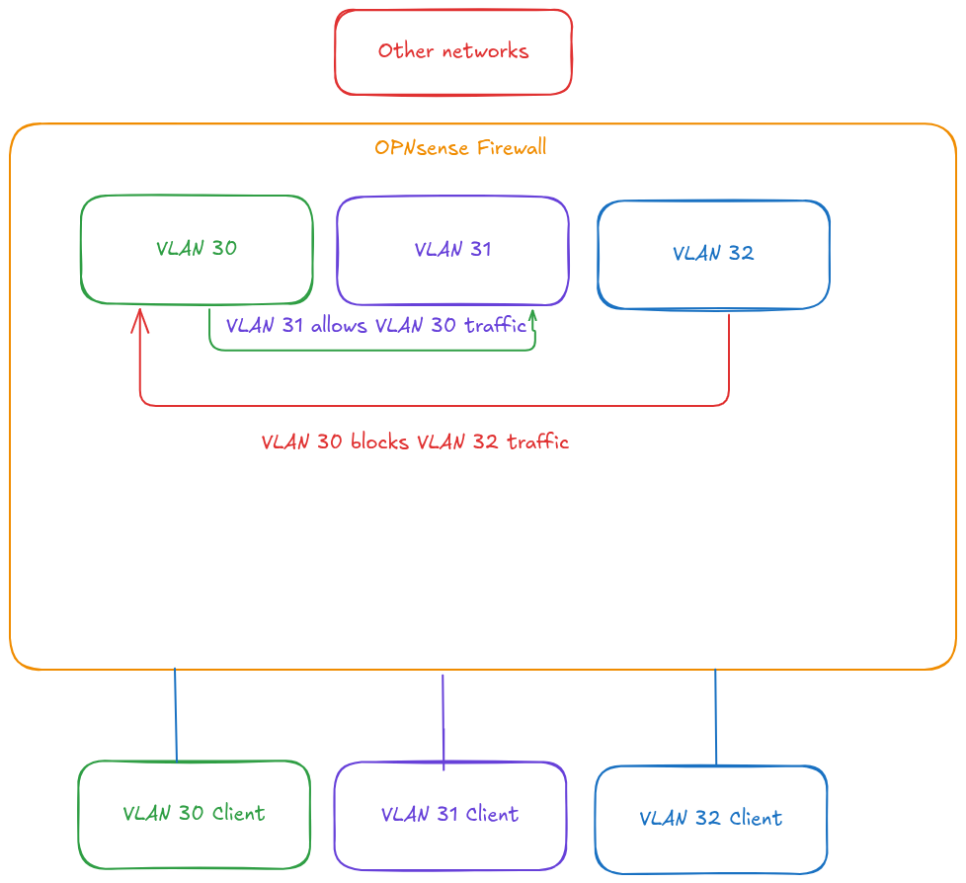
What Is A Firewall
The bouncer at a party's front door
Boundary of two networks, LANs or WANs in any combo
Rules guide what's allowed; ports, subnets, etc.
Without one, devices on your network are exposed to anything on the internet trying to reach it
Lesson 1
Notes:
The bouncer at a party's front door, checking a list of people and rules they've beengiven before letting anyone in or out.
Checkpoint that decides what network traffic is allowed through
Boundary of two networks – most commonly between your LAN, other LANs, and theInternet
Rules guide the decisions: types of services allowed, IP/subnets allowed,source/destination, etc.
Can be dedicated with hardware, or software like OPNsense
Without one, every device on your network is directly exposed to
anything on the internet trying to reach it
Go through a configured opnsense, and show me changing the rules and then being able to ping vs not

Slide 78
Showing Rule Changes
Editing my completed OPNsense VMs
Lesson 1
Notes:
Show them how I can't currently talk to one on another subnet, but then change rules so that I can
VLAN 20 is pinging 21; change 21's opnsense rules to allow all communication from 21, right after the only other allow command

Slide 79
Logging In
Your own OPNsense firewall VMs
Lesson 1
Notes:
Show them how I can't currently talk to one on another subnet, but then change rules so that I can
VLAN 20 is pinging 21; change 21's opnsense rules to allow all communication from 21, right after the only other allow command

Slide 80
OPNsense VM IP | Your VM ID
 | 120
 | 121
 | 122
TBD | 130
TBD | 131
Everyone has this info
User: root
Password: opnsense
Enter the IP into your browser to access web interface
TBD | 132
TBD | 140
TBD | 141
TBD | 142
TBD | 150
TBD | 151
TBD | 152
Your OPNsense VM will manage only your VLAN, and thus only your VM. Start up your OPNsense VM and open its console.
Lesson 1

Slide 81
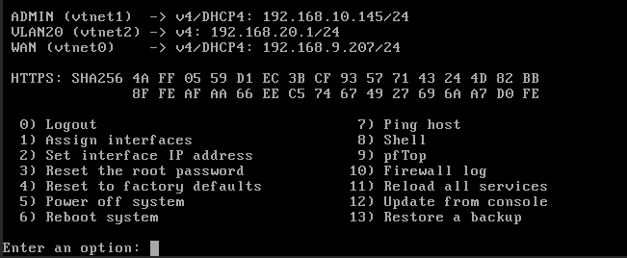
It should look like this. ADMIN is LAN on .10 subnet, WAN is .9, and your VLAN is configured to a gateway IP
We need the ADMIN IP since that is the IP we type into the search bar to see the web interface
Lesson 1

Slide 82
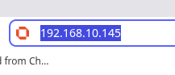
Acess the Web User Interface
This will be different for everyone's OPNsense VM's!! Insert your own
Type your vtnet1 LAN IP into the search bar (not the one in the picture)
User: root
Password: opnsense
Lesson 1

Slide 83
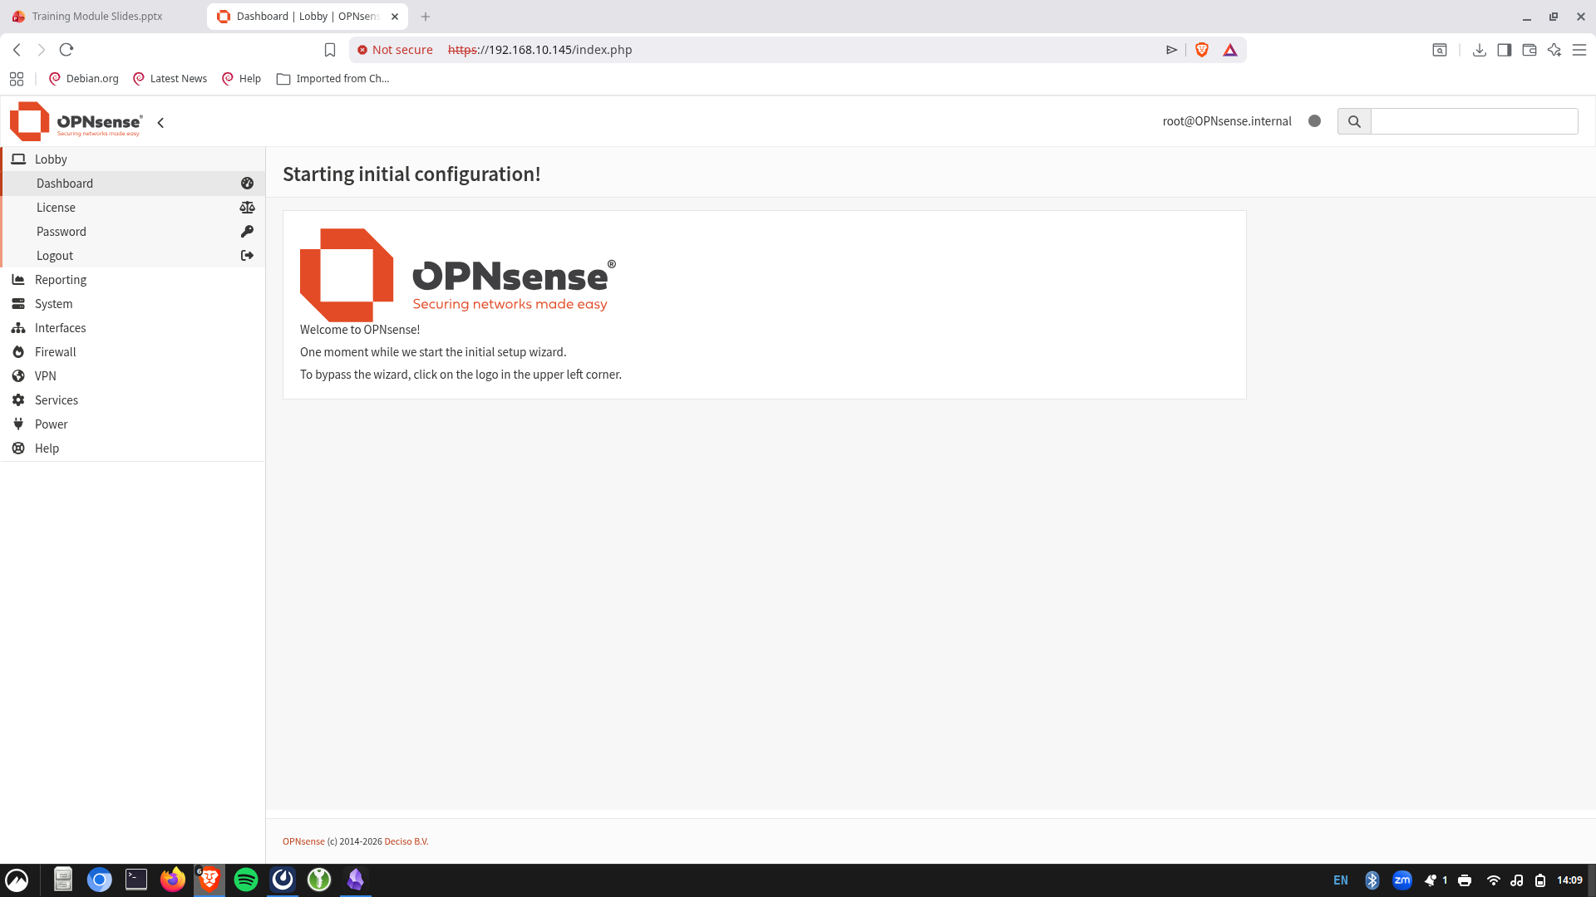
Lesson 1

Slide 84
10 Minute Break

Slide 85
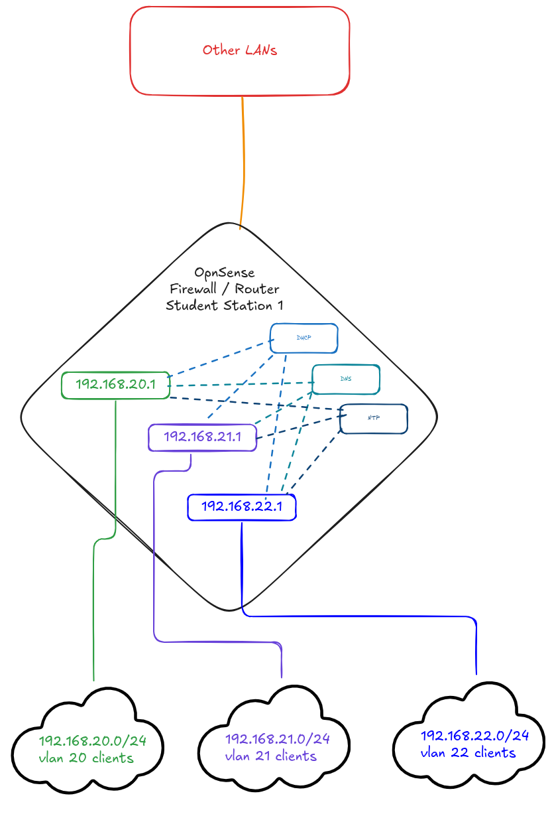
Configuring Services
This is what our OPNsense firewall will be distributing service-wise to your host(s)
Lesson 2
Notes:
Make sure diagram is the firewall with ports coming out. And it should be talking to other LANs in our case.

Slide 86
DHCP/DNS Config
Lesson 2

Slide 87
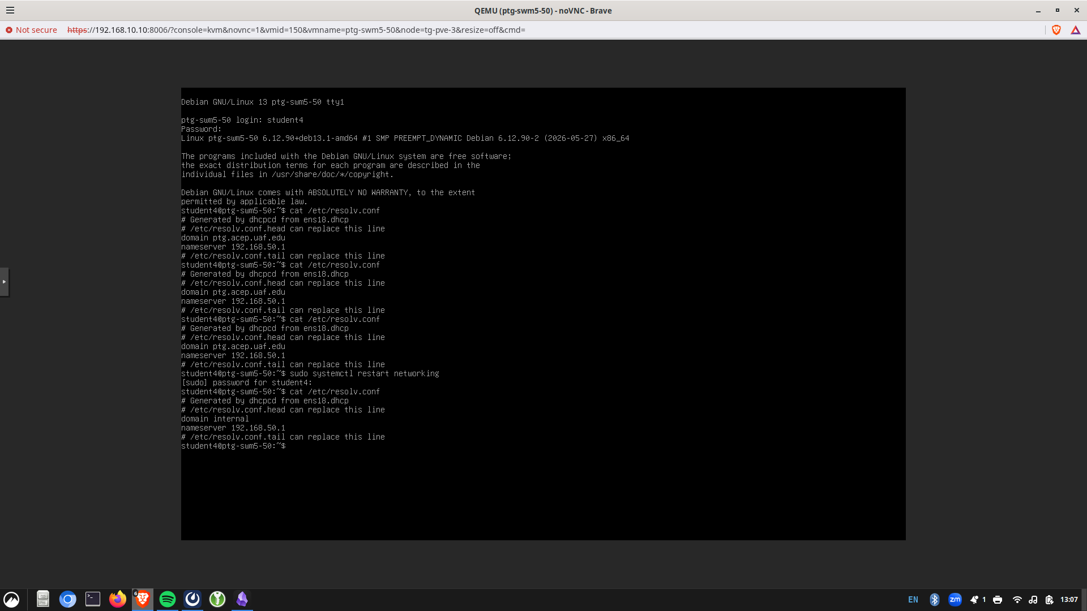
Example
Type cat/etc/resolv.conf
Internal is a local domain name
Common placeholder for devices inside a private network
We will change it for organizational purposes
Lesson 2

Slide 88
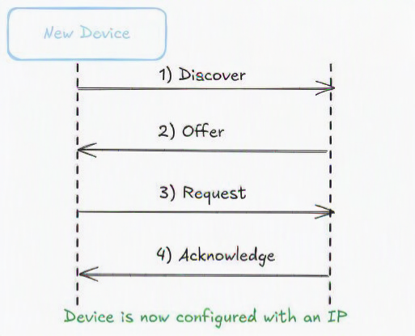
DHCP
Firewall DHCP Service
In Module 1, your VM asked a DHCP server for an address.
You define DHCP ranges
What range makes a good DHCP pool?
Now, OPNsense is that server for your VLAN.
Your LAN clients get these IPs
Lesson 2
Notes:
Third bullet is call back to slide 18 and some reserved stuff like gateways

Slide 89
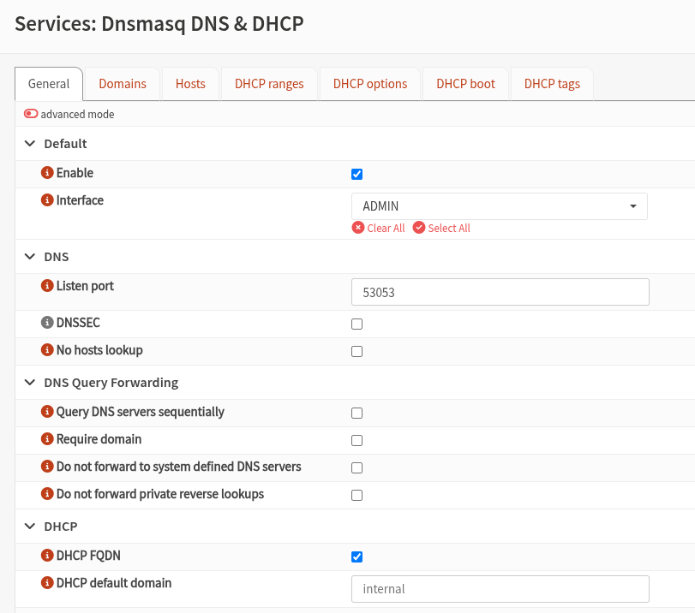
Setting DHCP/DNS
Go to Services > Dnsmasq > general
What should we change?
Lesson 2

Slide 90
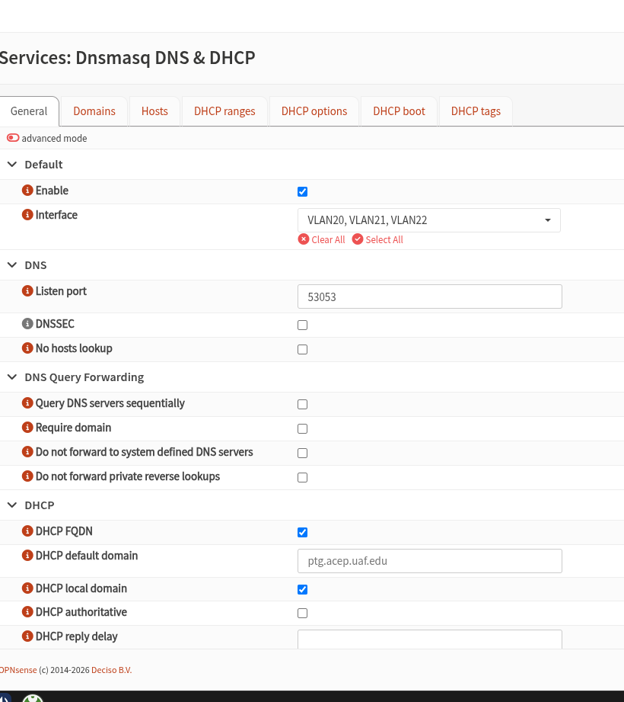
Setting DHCP/DNS
Change the ADMIN interface to your VLAN gateway
Helps organize devices under a common network domain.
Makes it easier to resolve hostnames without typing the full domain.
Does not change IP addresses, routing, or Internet connectivity.
Lesson 2

Slide 91
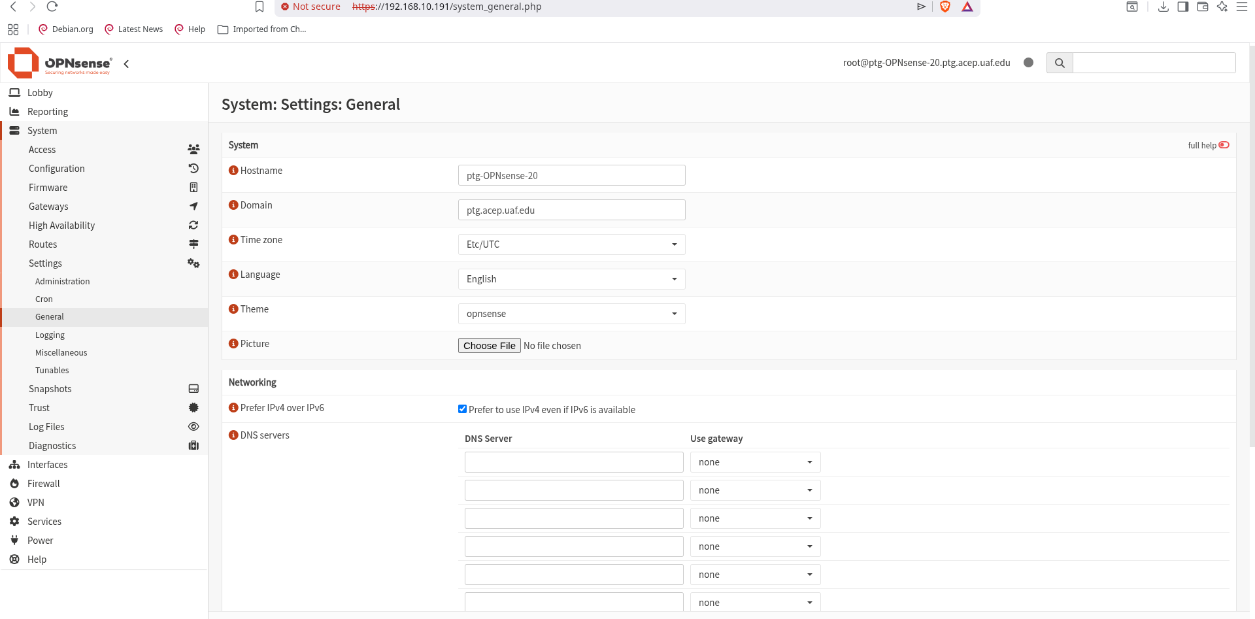
Lesson 2

Slide 92
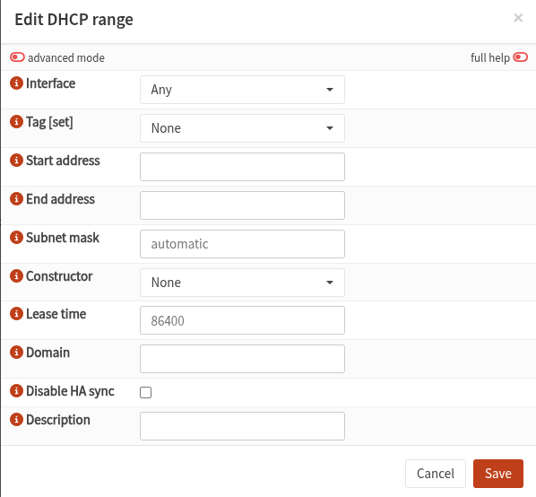
Client Ranges
Services > Dnsmasq > ranges
Click the + in the bottom right
What should we change?
Lesson 2

Slide 93
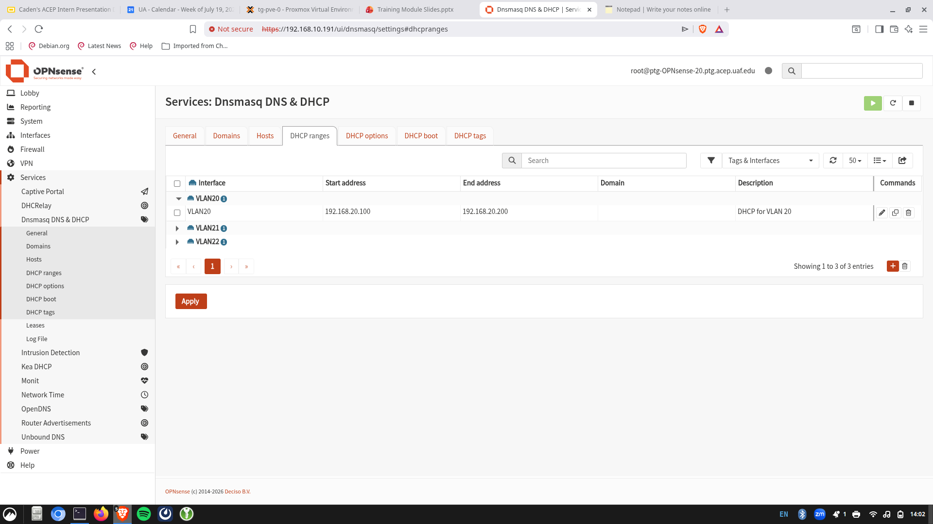
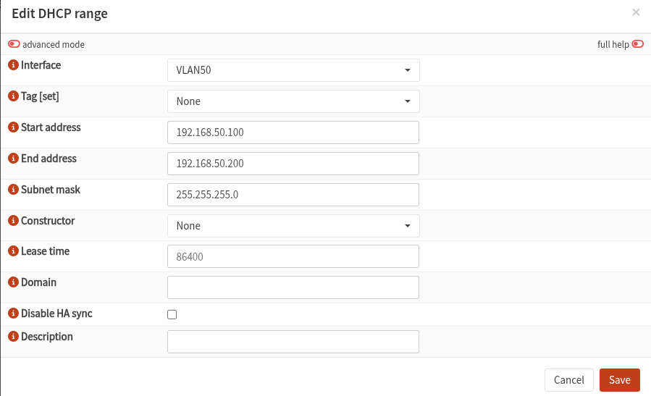
Client Ranges
Services > Dnsmasq > ranges
Click the + in the bottom right
Edit each of the 3 VLANs in your group
Lesson 2
Notes:
They will need to do this for each VLAN

Slide 94
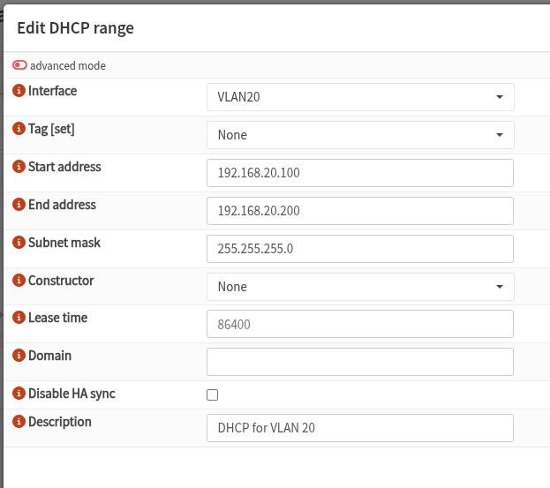
Client Ranges
Services > Dnsmasq > ranges
Click the + in the bottom right
What should we change?
Lesson 2

Slide 95
Return to Example
Type cat/etc/resolv.conf
What is the difference?
We want meaningful naming across our network
Lesson 2

Slide 96
DNS
OPNsense can forward requests upstream or resolve them itself
Unbound DNS provides local DNS for LANs
For looking up non-LAN services, OPNsense will upstream them
Lesson 2
Notes:
unbound dns server is providing local dns for local area networks. Authoritative source for local dns. Everything inside networks on LAN sides, all of them, Name mapping correct is decided by opnsense server, but for looking up non-lan serviceds specififed in opnsense it will upstream it to get the name mapping for hosts try google

Slide 97
NTP Config
Lesson 2

Slide 98
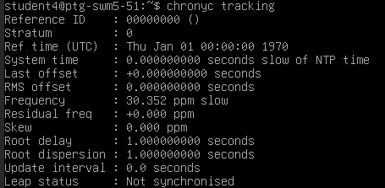
Apparent Time Tracking Issue
Return to your VM on this subnet and type "chronyc tracking"
Notice the "Leap Status";
Not currently synced to NTP
It is currently not syncing time for the Alaska system we will add to later "update interval"
Notes:
don't need to sync within lan for ntp, can use wider netwrok because peolpe don't run own ntp servers. Matters in like a utility entwork because if internet goes dw n it will need a local one

Slide 99
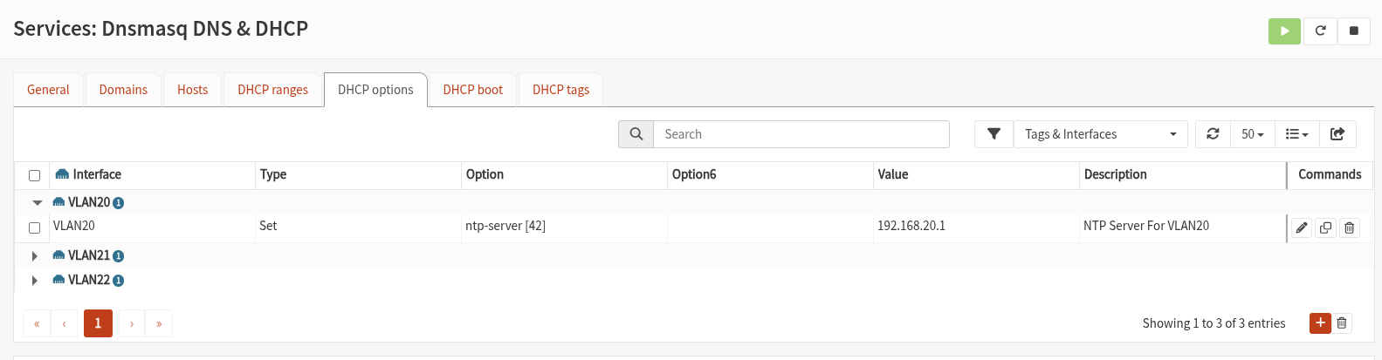
Setting NTP
Go to Services > Dnsmasq > DHCP options. Click the + in the bottom right
Devices will synchronize to the firewall then internet
DHCP option 42 advertises an NTP server to clients on VLAN20.
When devices on your VLAN obtain an IP -> gateway address as time server.
Hosts have synced clocks automatically
Lesson 2

Slide 100

Setting NTP
Use your own VLANs
The value means we are using the gateway for devices to sync time through
Lesson 2

Slide 101

Setting NTP
Go to Services > Network Time > General
The only thing we are changing on this page is to add our ntp path
Click the + in the bottom left, and add the "ntp.alaska.edu" into the new box.
Check "prefer" here
Lesson 2

Slide 102

Returning to Testing!
Return to your VM on this subnet and type "chronyc tracking"
Notice the time sync on "system time" and "root delay"
It is currently synced much closer than before due to NTP

Slide 103
Firewall Rules Config
Lesson 3

Slide 104

Firewall Rules
A firewall rule is just a statement: "For this type of traffic, from here, to there, on this port, allow or block it
"Or" analogy: First match wins
Final "block all else" rule
Good rules are specific.
Test your rules immediately
Lesson 3
Notes:
Specifc rule example: "Allow LANdevices to reach port 443 on the internet"> "Allow all LAN traffic"
Ask why we would want a block vs a reject

Slide 105
Practice – LAN Interface:
# | Action | Interface | Source | Destination | Port
1 | Pass | LAN | LAN net | any | 443
2 | Pass | LAN | LAN net | any | 53
3 | Block | LAN | LAN net | any | 80
4 | Block | LAN | any | any | any (default rule)
Q1 A laptop on your LAN visits a website over plain HTTP (port 80). Pass or block? Which rule decides it, and why doesn't rule 1 apply, even though it's also about web traffic?
Q2 That same laptop launches an online game using port 25565. Pass or block? Which rule decides it?
Lesson 3

Slide 106
Answers
Q1 is Blocked, by rule 3. Rule 1 only matches port 443. Port 80 is a different port, so rule 1 never applies, so every field (source, destination, port) has to match.
Q2 is Blocked, by the bottom "catch all" rule. Nothing in rules 1 through 3 mentions port 25565, so nothing matches until the catch-all at the bottom. No matching allow rule means it is blocked.
Lesson 3

Slide 107
Practice:
# | Action | Interface | Source | Destination | Port
1 | Pass | WAN | 192.168.20.50 | LAN net | 22
2 | Block | WAN | any | LAN net | 22
3 | Pass | WAN | any | LAN net | 443
4 | Block | WAN | any | any | any (default rule)
Q1 A connection arrives from 192.168.20.50 trying SSH (port 22). Then a connection arrives from 192.168.50.9, also trying SSH. What happens to each, and why are the outcomes different?
Q2 Suppose rules 1 and 2 were swapped, "block SSH from anyone" listed first, "allow SSH from 192.168.20.50" listed second. Would the trusted admin at 192.168.20.50 still get in?
​
Lesson 3

Slide 108
Answers
Q1 192.168.20.50 passes (matches rule 1 exactly because it's the right source and right port). 192.168.50.9 is blocked (fails rule 1's source check, falls through to rule 2's blanket block). Source is just as much a required match as port.
Q2 No, as the admin gets blocked too. "Block SSH from anyone" matches anyone, including 192.168.20.50. The first match wins, so OPNsense never reaches the specific allow rule below it. Order alone can defeat an otherwise-correct rule.
Lesson 3

Slide 109

Setting Up Some Baseline Rules
Setting up a baseline for you to edit afterwards that will give you familiarity
Navigate to: Firewall > Rules [new]
Click the "all rules" bar on top, then select "VLANXX"
One person in your group should do this for each VLAN
Lesson 3

Slide 110

It Will Be Blank
Lesson 3

Slide 111

First Rule
We want to deny all IPv6 traffic on this VLAN since we won't be using it
What should we change?
Lesson 3

Slide 112
First Rule
Lesson 3

Slide 113

Second Rule
We want to allow VLAN50 to talk to itself in all cases (e.g. gateway); not usually needed as a command
What should we change?
Lesson 3

Slide 114
Second Rule
Lesson 3

Slide 115

Third Rule
We want to deny traffic from all other VLANs?
What should we change?
Lesson 3

Slide 116
Third Rule
Lesson 3

Slide 117
Fourth Rule
We want to deny all other traffic not specifically approved
What should we change?
Lesson 3

Slide 118

Fourth Rule
Lesson 3

Slide 119
Our Baseline For All 3 VLANs Is Set
Lesson 3

Slide 120
Testing!
We'll log into the VMS now that firewall services are configured

Slide 121
Type this into your search bar
Lesson 1
Notes:
They will type the address into their search bar to reach the interface
They need proxmox because they will need console access when they reset IPs, so if they tried to WSSH it would kick them out and we don't want to deal with that
SO to reduce the amount of logins I am having them just start module 1 with proxmox, then do wssh with module 2

Slide 122
Everyone's username and password will be handed out and be student# where # is assigned to you
student1
Lesson 1

Slide 123

Click on "tg-pve-0" on the left side once. Then, you should see this.
Lesson 1
Notes:
They'll click on tg-pve-0 and this should come up. They will be on the VMs names ptg-V20-M1

Slide 124
Student | VM ID
StudentName | 192.168.xx.xxx
StudentName | 192.168.xx.xxx
StudentName | 192.168.xx.xxx
StudentName | 192.168.xx.xxx
StudentName | 192.168.xx.xxx
StudentName | 192.168.xx.xxx
StudentName | 192.168.xx.xxx
StudentName | 192.168.xx.xxx
StudentName | 192.168.xx.xxx
StudentName | 192.168.xx.xxx
StudentName | 192.168.xx.xxx
StudentName | 192.168.xx.xxx
We will pass out sheets with your username, password, and VM for this part.
Lesson 1

Slide 125
Challenge 1:
Note: all challenges only need you to edit the VLAN interfaces for your OPNsense. They will only require you to work in your current groups
Goal: In your groups, get Teammate A able to ping Teammate B. Teammate B should still not be able to ping Teammate A.
Lesson 3
Notes:
Only one rule needed now, and it lives on A's interface tab only: Pass, Interface = [A's VLAN], Protocol = ICMP, Source = [A's VLAN] net, Destination = [B's VLAN subnet]
Nothing changes on B's tab. B still can't reach A because B's tab still only has the baseline (no rule permitting B to A), and A's own tab was never touched to allow anything in from B.
If a group asks "don't we need to also touch B's interface?" And that's the exact misconception to correct: the destination side doesn't need to agree for a ping to arrive, only for it to be initiated. Good moment to ask them to explain, in their own words, why that's true.

Slide 126
Challenge 2:
Note: all challenges only need you to edit the VLAN interfaces for your OPNsense. They will only require you to work in your current groups
Goal: Make Teammate B and Teammate C able to ping each other, both directions. Teammate A should be unreachable by, and unable to reach, either of them.
Lesson 3
Notes:
Two rules, but now both live on the same box, that's the contrast with Challenge 1 worth calling out:
On B's tab: Pass, ICMP, Source = B's VLAN net, Destination = C's VLAN subnet
On C's tab: Pass, ICMP, Source = C's VLAN net, Destination = B's VLAN subnet
Leave A's tab untouched as the baseline already keeps A isolated in both directions.
Ask groups directly: "why didn't you need to touch A's tab to keep A blocked?", which reinforces that isolation is the default, not something they have to actively maintain per challenge.

Slide 127
Challenge 3:
Note: all challenges only need you to edit the VLAN interfaces for your OPNsense. They will only require you to work in your current groups
Goal: A rule on Teammate A's tab is currently too generous, as it lets A reach both B and C. Create the "generous rule", then change it so only B is reachable from A.
Lesson 3
Notes:
Have them add an overly broad rule on A's tab before this challenge, like initial accept everythign. Pass, ICMP, Source = A's VLAN net, Destination = any (or both B's and C's subnets)
Fix: narrow the Destination field down to just B's subnet, rather than deleting and rebuilding.
Note the shift from Challenge 3's old version: before, the fix was narrowing source (who can reach you). Now it's narrowing destination (what you can reach), which is worth naming, since it's easy to assume "specificity" only ever means one thing.

Slide 128

Feedback Form

